Slide 1

Data Science Concept Maps
a remixable collection of teaching resources

Slide 2
How To
Mail Greg Wilson (greg.wilson@rstudio.com) for write permission
Add a slide with the topic as a title
Use Google Slides’ drawing tools rather than pasting in an image
Put your name and contact information in the speaker notes along with any other information or explanation you want.
If you are redrawing or modifying a concept map someone else has created, please add yourself in the speaker notes as well.
By contributing, you agree to make your material available under the
Creative Commons - Attribution 4.0 International License
and to abide by the
Contributor Covenant Version 2.0

Slide 3
Data Types in R
tidy
if cleaned becomes
untidy
databases
consists of
can be
data
stored
in
csv files
can be read into
R
observations
variables
has different
excel sheets
in
in
data types
can contain different
rows
columns
can be
only contain single
character
such
as
basic
matrices
vectors
numeric
lists
are fancy
compound
such
as
logical
data frames
Notes:
Original source: Megan Beckett
Redrawn: Brendan Cullen

Slide 4
Factors in R
value validation
bars ordered NOT in abc
efficient storage
helps
useful for
underpins
limited set of possible values
integers with name mapping
implemented as
Factors
have
can be
example
integers are ordered
weekdays
ordered/unordered
changeable
Notes:
Ildiko Czeller, czeildi@gmail.com

Slide 5
Factors in R
Text
Numeric
include
Representations in R
have
Data Types in Real Life
are
affects
Models
include
controls
represented by
Factors
Categorical
controls
Order
Charts
have unique
implies unique
created
with
easier
with
controls
Tables
Levels
forcats package
factor()
have
Notes:
Graham Parsons

Slide 6
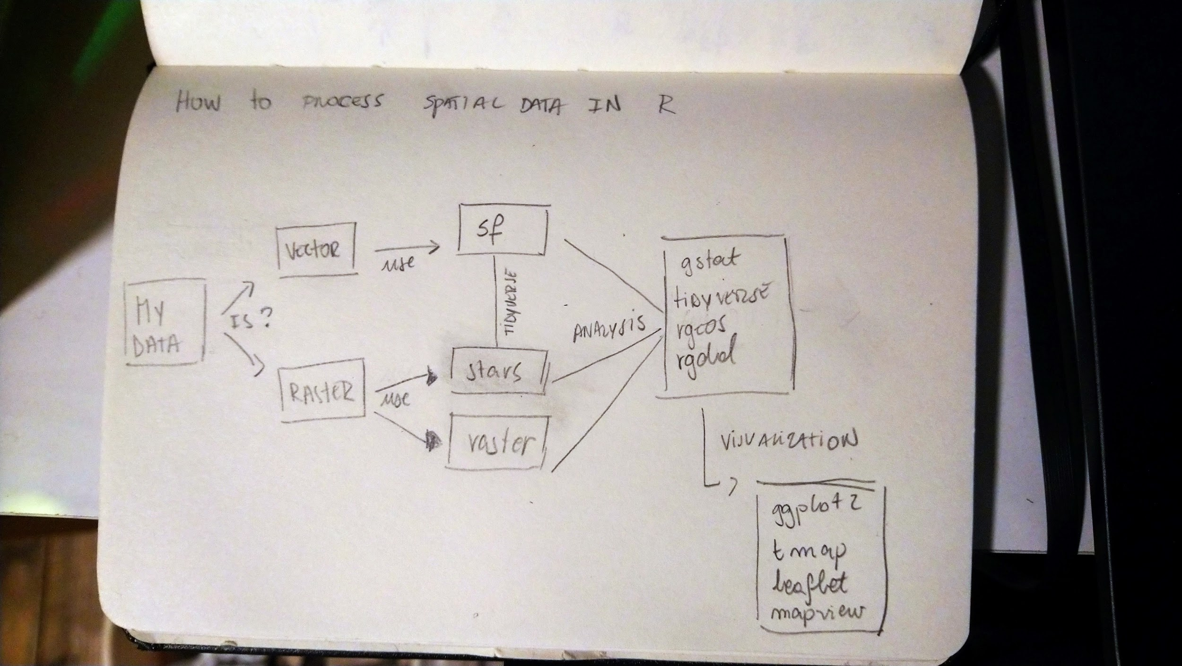
Spatial Data in R
Notes:
Stephanie Orellana

Slide 7
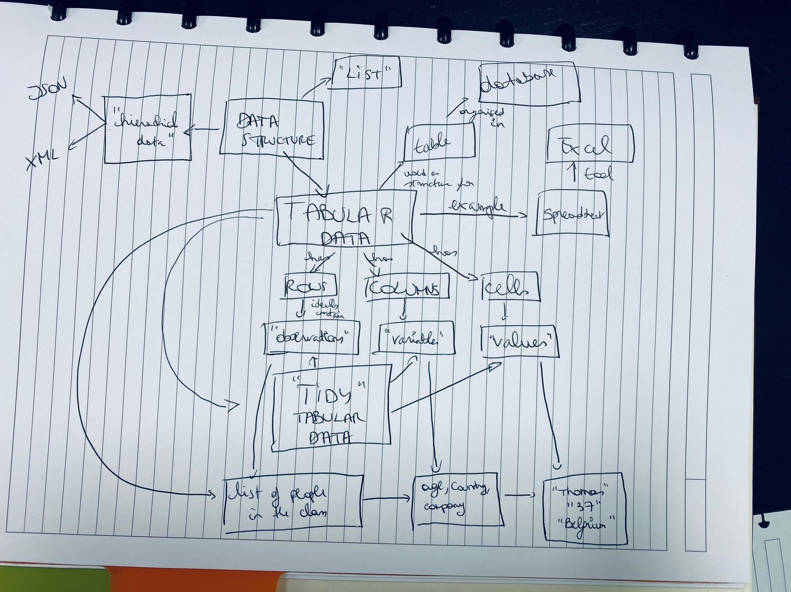
Tabular Data
Notes:
Thomas Michem

Slide 8
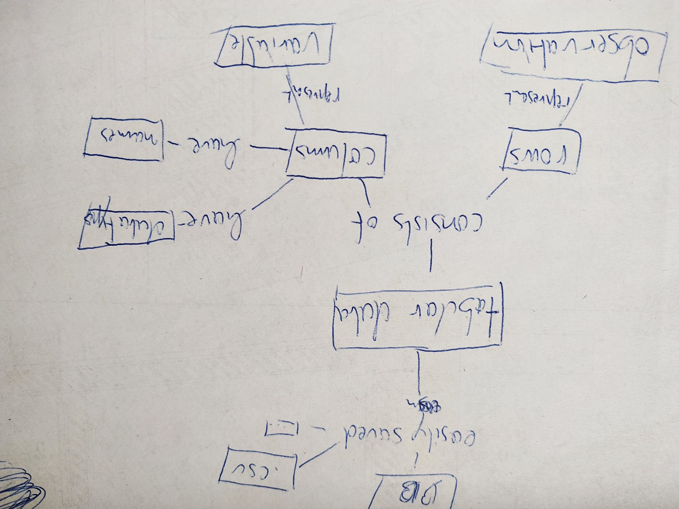
Tabular Data
Notes:
Lukas Löber

Slide 9
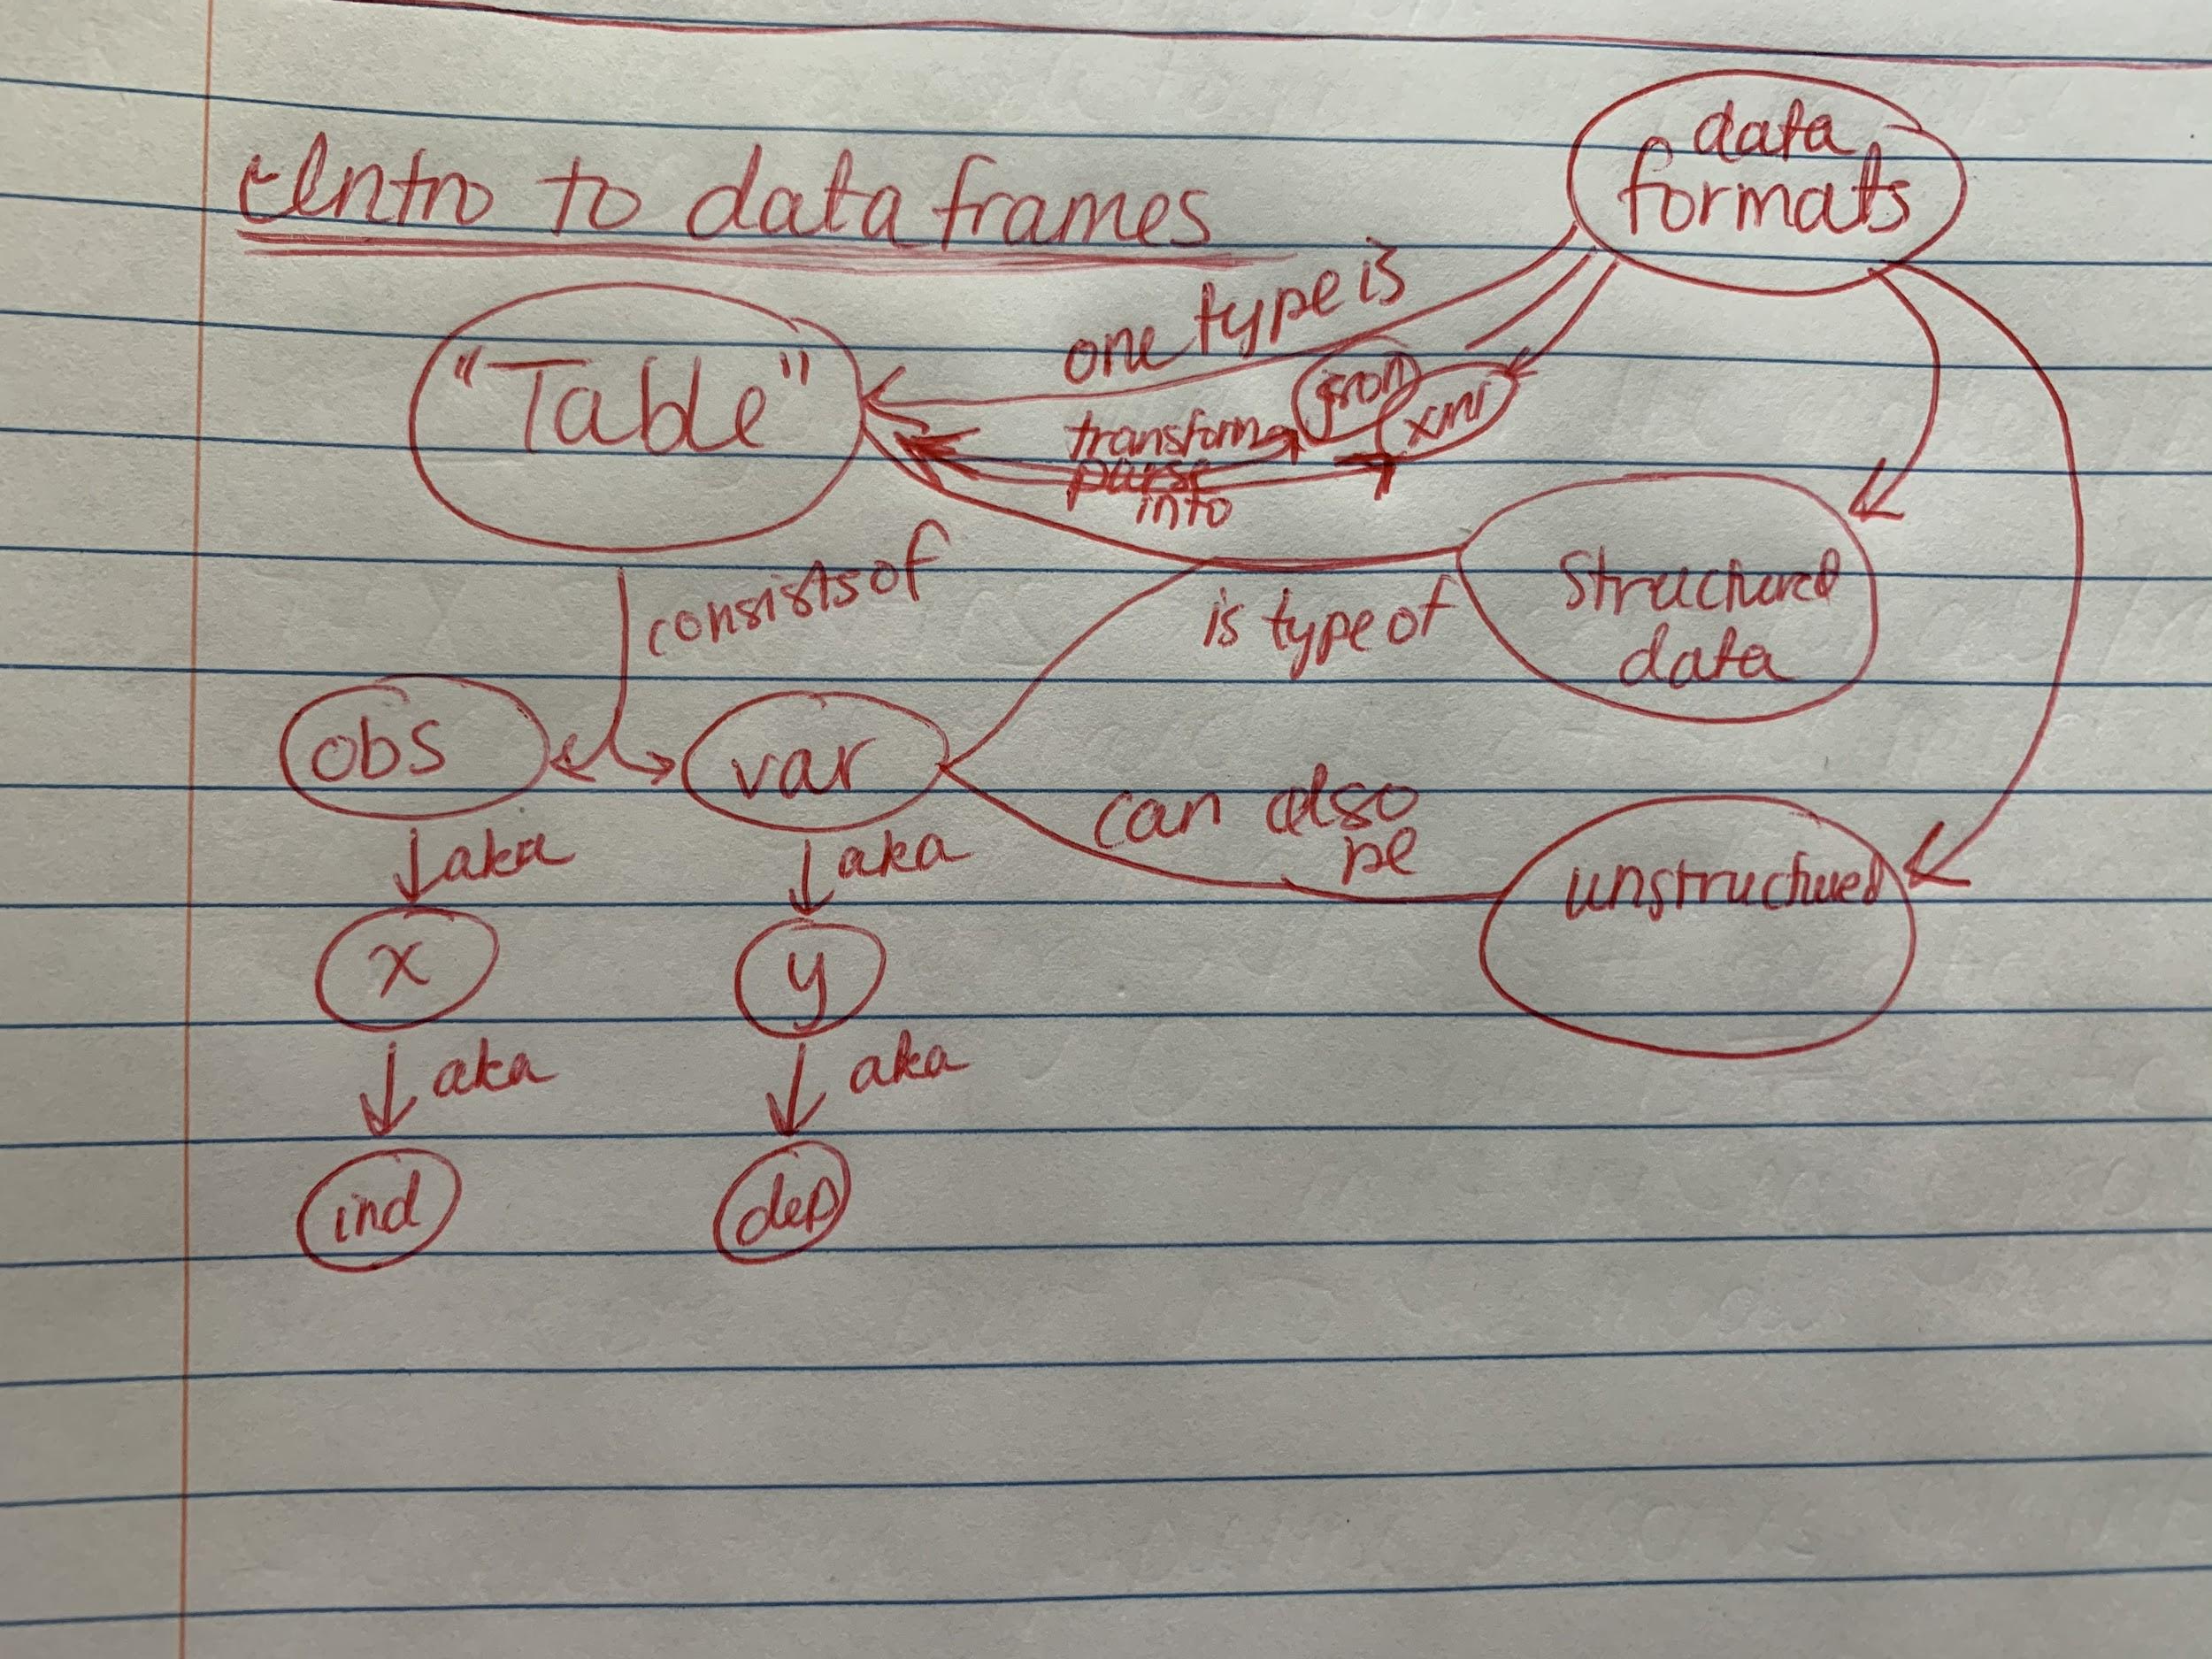
Data Frames
Notes:
Shivani Patel

Slide 10
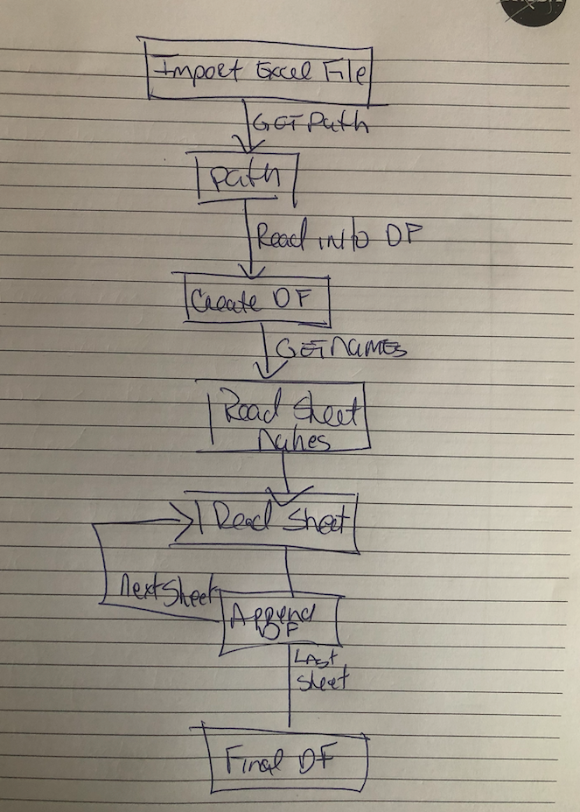
From Excel to a Data Frame
Notes:
David Meza

Slide 11
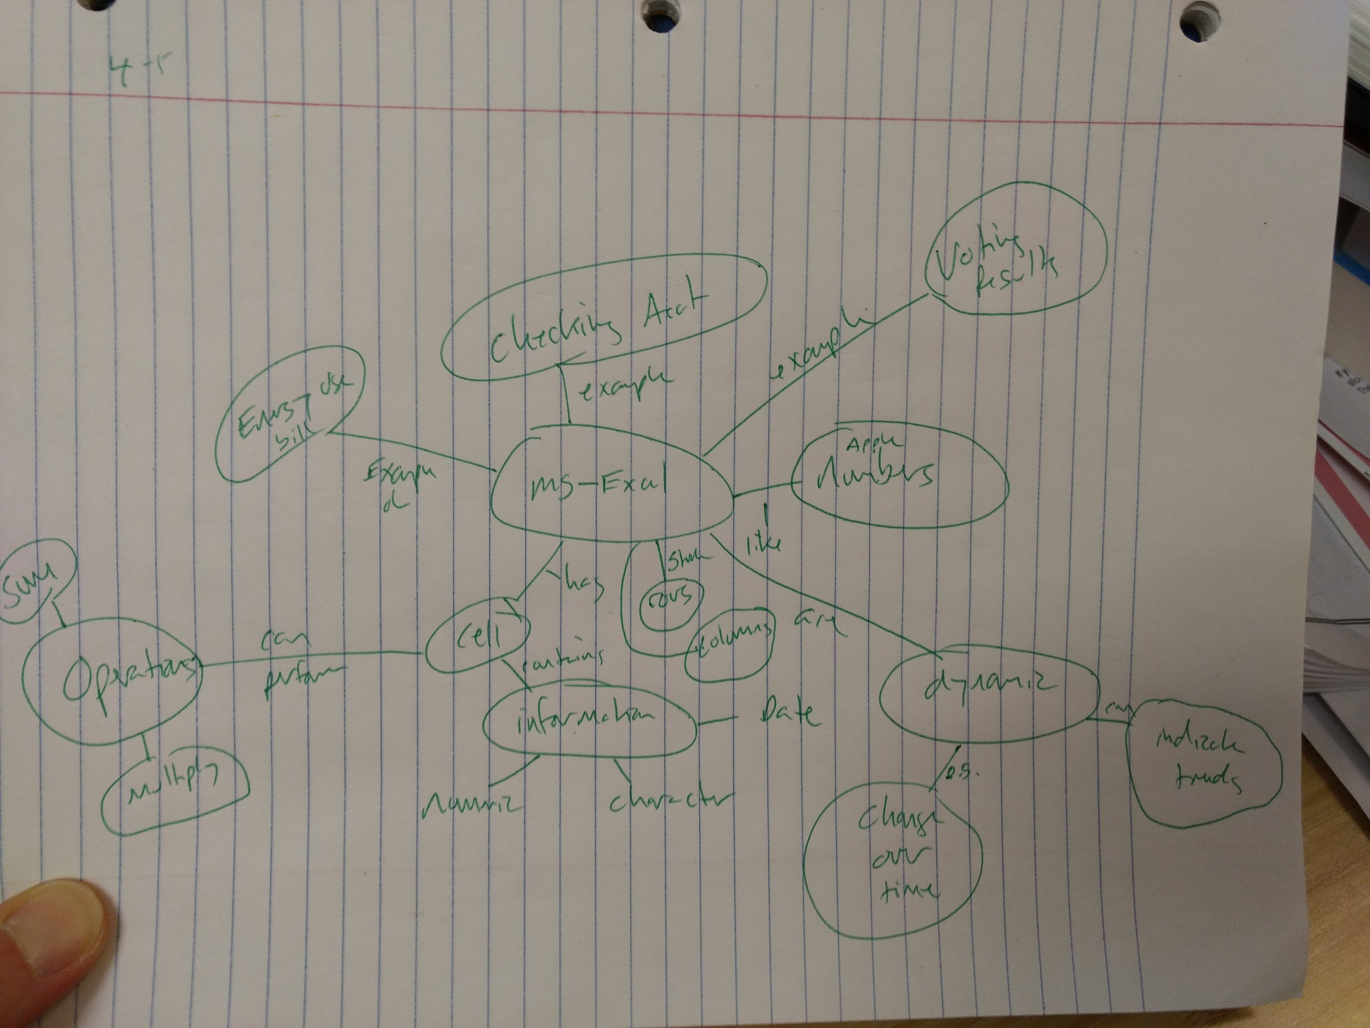
Excel
Notes:
Rob Schick

Slide 12
Getting data
other “flat files”
library(readr)
read_delim()
csv
library(readr)
read_csv()
Connect to a database
library(odbc)
library(DBI)
Read in flat files
Load it from within
data()
Statistical Packages
library(haven)
read_spss()
Excel
library(readxl)
read_excel()
Scraping
library(rvest)
library(RSelenium)
Getting data in R
Find it on the web
Generate it
runif()
nrorm()
sample()
APIs
library(httr)
library(googleAnalyticsR)
library(rtweet)
Notes:
Alex Chisholm
Missing pieces?
Json → library(jsonlite)

Slide 13
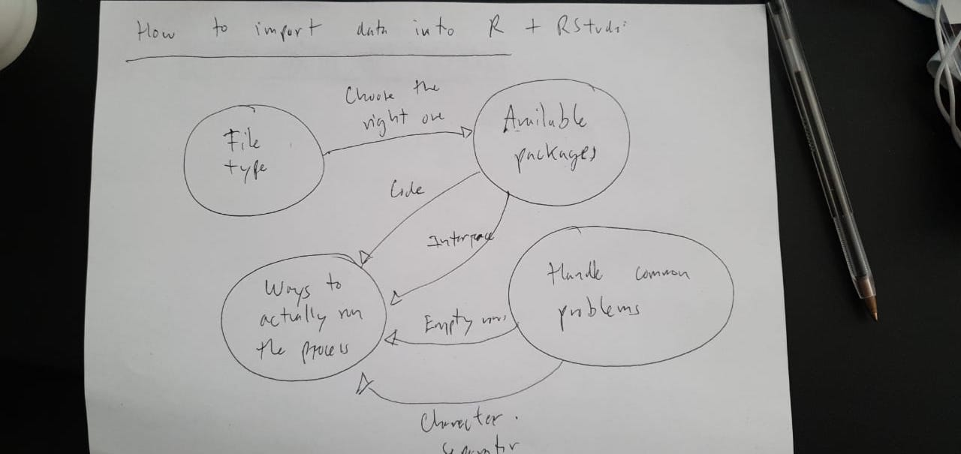
Importing Data
Notes:
Sebastián Garrido de Sierra

Slide 14
R Markdown Websites
not online yet local
render_site()
see something that looks like a site w/pages
LINKS PAGES TOGETHER
_site.yml
knit all in
one step
view in a web browser
.Rmd page
.Rmd page
docs/
html
html
html
the real internet
render_site()
to create .html version
.Rmd page
needs to be in a docs/ otherwise GitHub pages doesn´t care
LIVE SITE on GitHub Pages
Notes:
Original: Desirée de Leon
Redrawn: Florencia D’Andrea

Slide 15
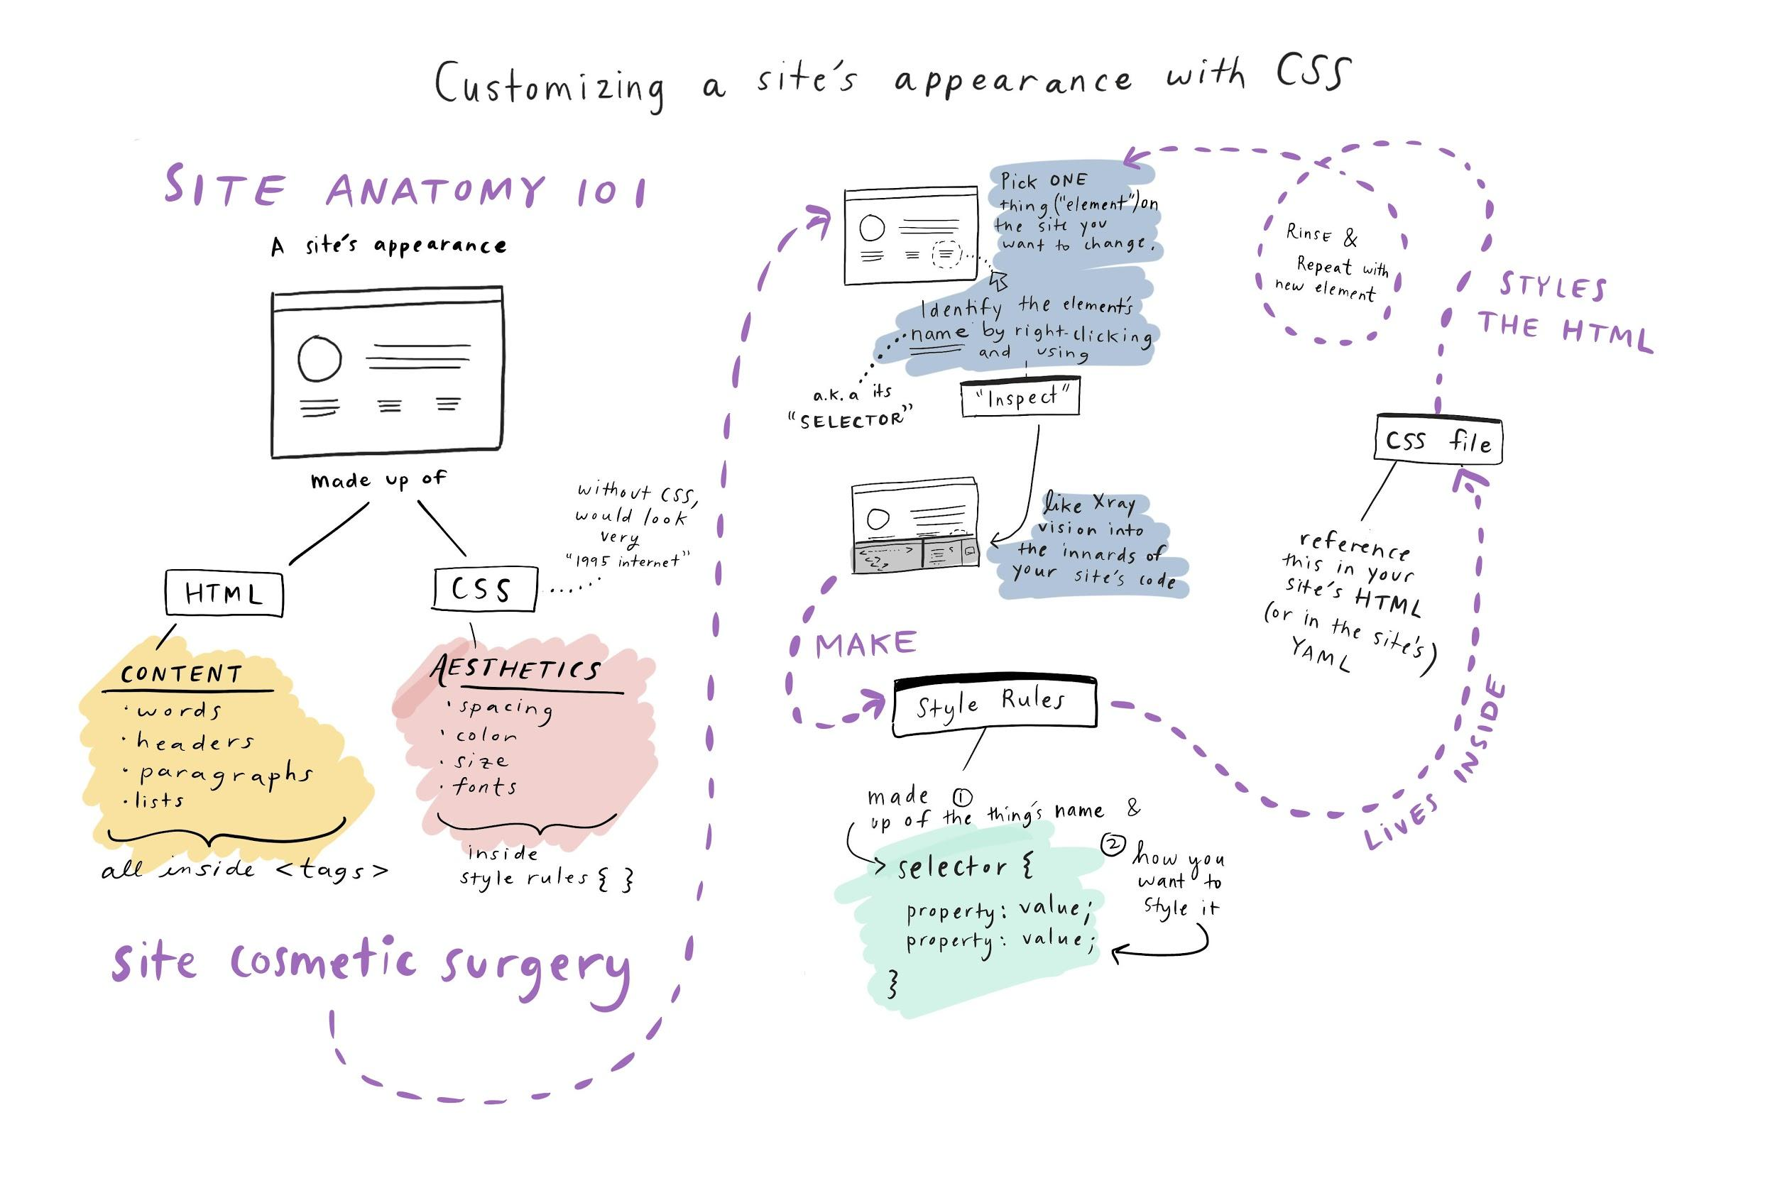
Customizing a Site’s Appearance with CSS
Notes:
Desirée de Leon

Slide 16
R Markdown
by
which contains:
RMarkdown
what is it?
A system to make reproducible documents
a flat text
file
.Rmd
code
text
outputs (results)
use for
combine
R
.R
Communicate
Collaborate
Have a tidy record of our work
Markdown
.md
by
workflow
more
common
pdf
html
word
and beautiful presentations
Many different formats
.Rmd .md
knitr
Pandoc
Notes:
Original: Gabriela Sandoval
Redrawn: Florencia D’Andrea

Slide 17
RMarkdown
specified
«in line»
symbols
specified
named
text
R code
chunks
specified
other content
YAML
have
can contain
control
can have
RMarkdown
behavior
name
params
has different
outputs
Notes:
Yanina Bellini Saibene

Slide 18
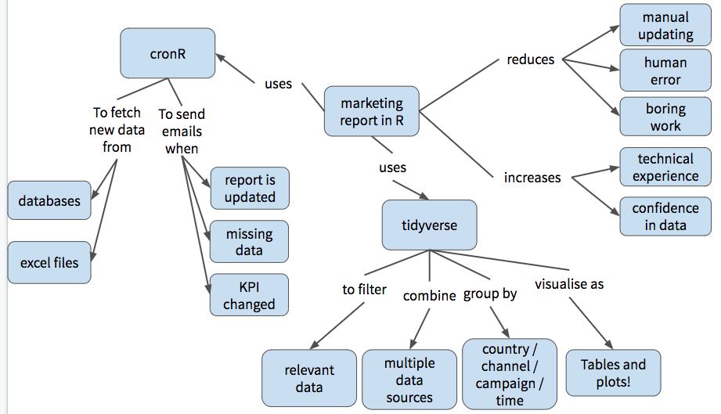
Marketing Reports with R
Notes:
Noa Tamir

Slide 19
Creating a Tableau Dashboard Product
Tableau Server
Clients
Tableau Workbook
Publish to...
Database How simple is the data?
Simple. Directly to...
Then to...
Send final version to...
Back to development
Share for...
Some transformation required.
Tableau Prep
No
Internal Review & Design Is it ready?
Yes
Needs a lot of work.
Routinely ask for...
R or Python
Finally to...
put into
Improve user experience
Get better data
Feedback
START HERE
Collect relevant data sets
Notes:
Alex Chisholm

Slide 20
Text Analysis
Punctuation
Tokenizing
Remove unnecessary character
Remove stopwords
Stemming
text pre-processing
text pre-processing
Text analysis classification
try to improve the model
Determine ???
Cross-Validation Scheme
confusion matrix
Model fitting
evaluate
train
testing
Notes:
Original: Ahmad Husain Abdullah
Redrawn by: Florencia D’Andrea

Slide 21
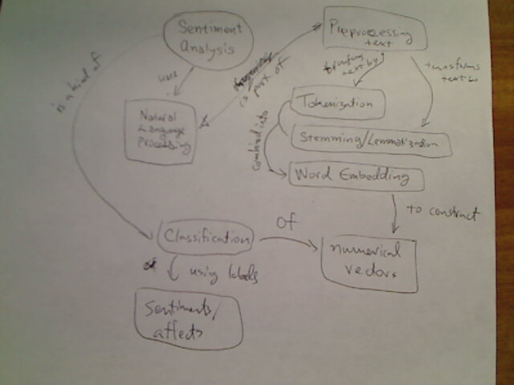
Sentiment Analysis
Notes:
Dhavide Aruliah

Slide 22
Data Clustering
Cohesion
Euclidean
Manhattan
Cosine
Separation
internal
Silhouette
can
be
Evaluation
Distance Measure
Curse of Dimensionality
Jaccard
external
Purity
measures quality of
affects
reduces efficacy of
F1 Measure
reduces
Feature Selection/ Reduction
PCA
Prototype
Set of Clusters
generates
Clustering
Algorithm
t-SNE
may contain
Correlation- based
illustrates
K-means
Agglomerative hierarchical
DBSCAN
scatterplot
dendrogram
Visualization
enables
heatmap
Notes:
Uli Niemann

Slide 23
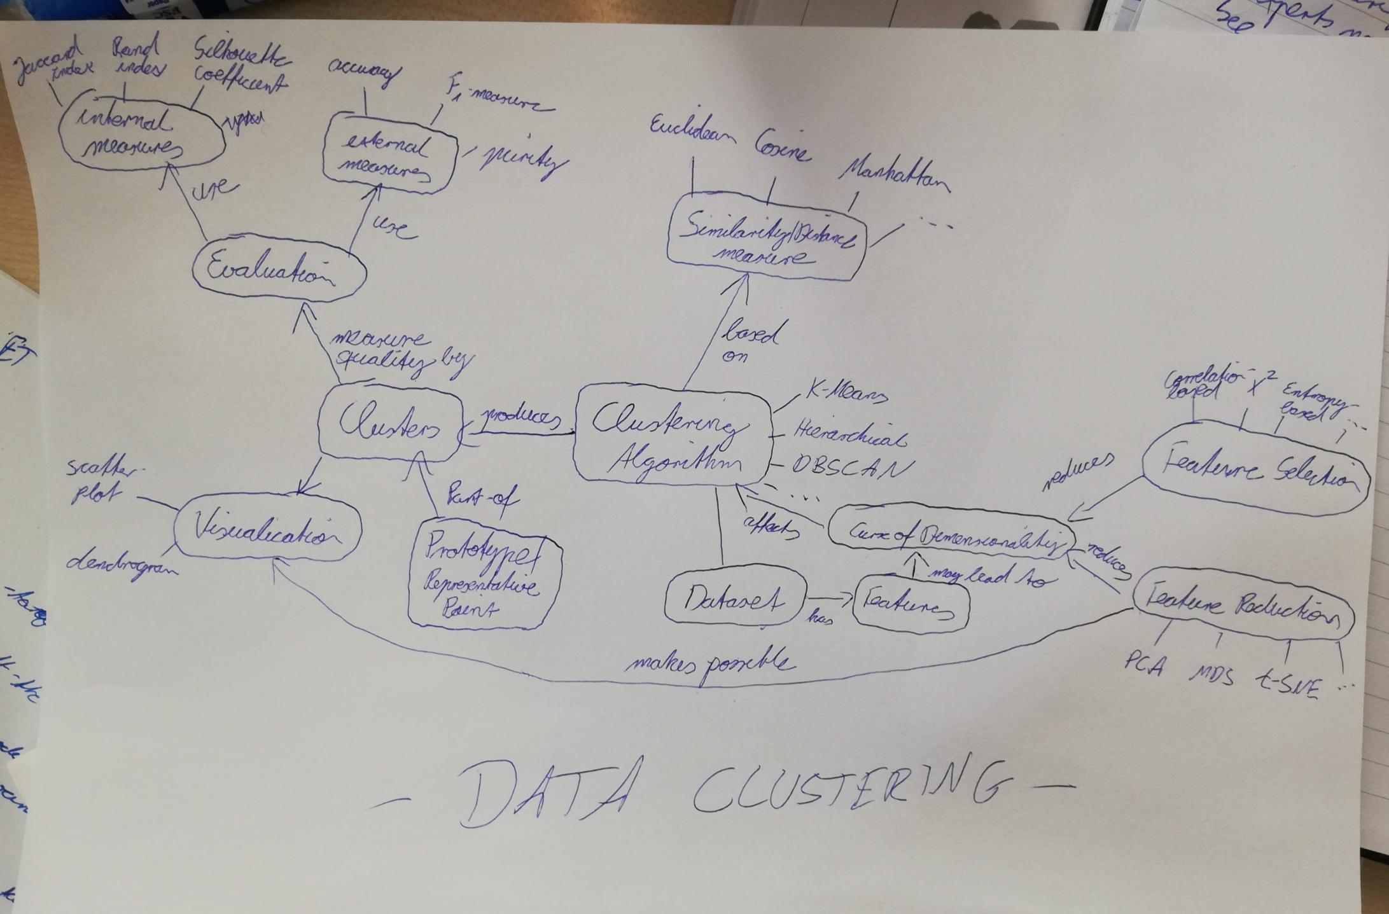
Data Clustering
Notes:
Uli Niemann

Slide 24
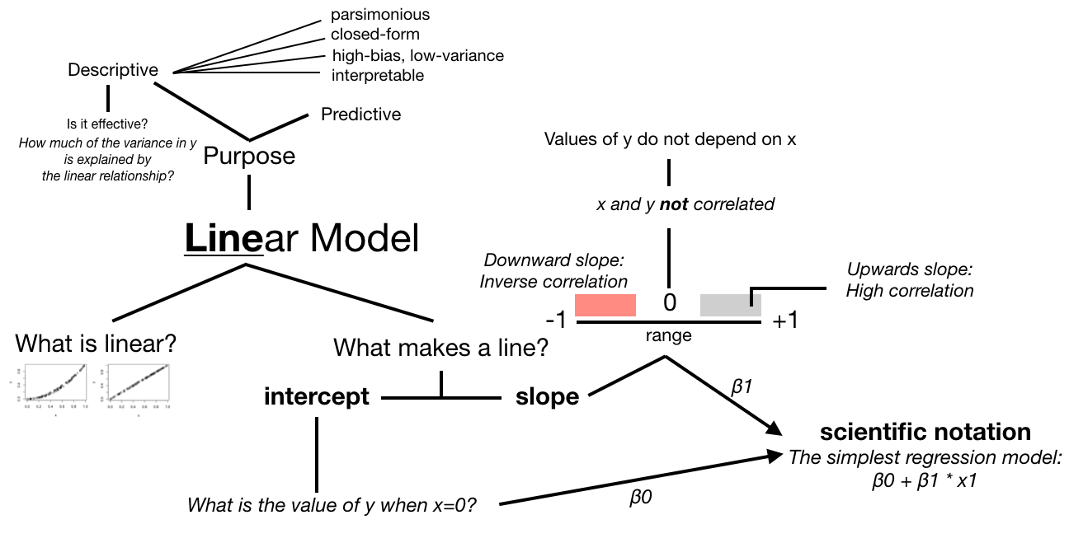
Linear Models
Notes:
Samuel Chan

Slide 25
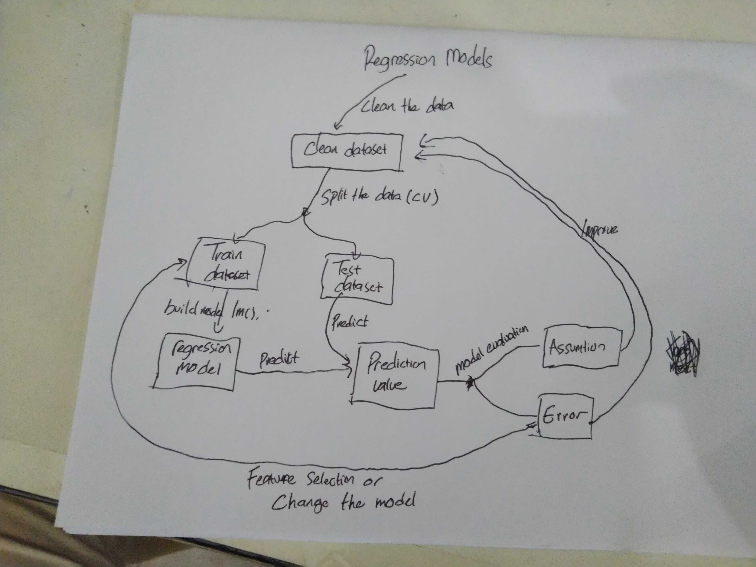
Regression Models
Notes:
David Tahi Ulubalang

Slide 26
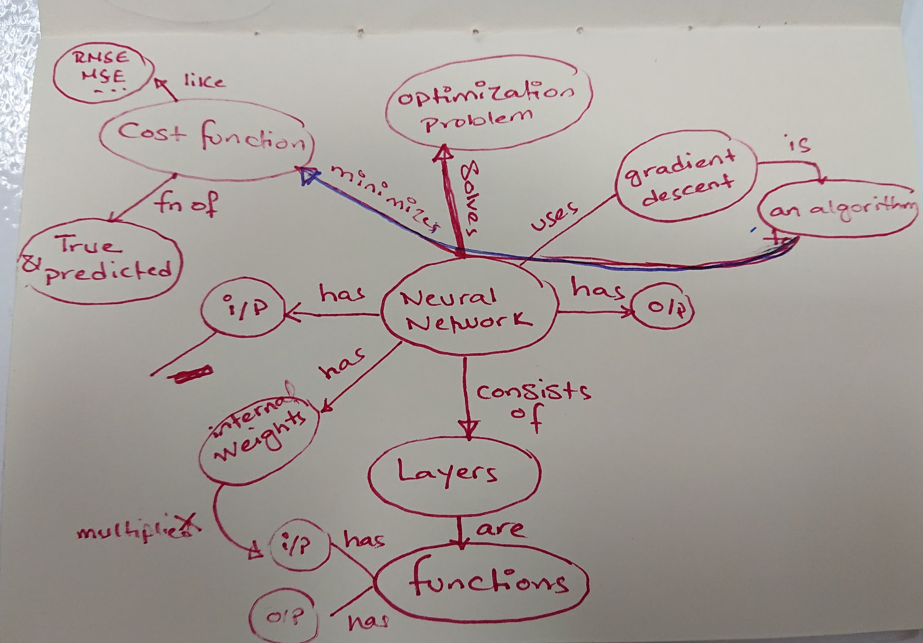
Neural Networks
RMSE
MSE
...
Optimization problem
like
Gradient descent
Cost function
minimizes
uses
is
solves
Fn of
has
Neural Network
i/p
An algorithm
True & Predicted
has
has
Consist of
o/p
Internal weights
layers
are
i/p
has
functions
multiplies
o/p
has
Notes:
Omayma Said
Redrawn: Florencia D’Andrea

Slide 27
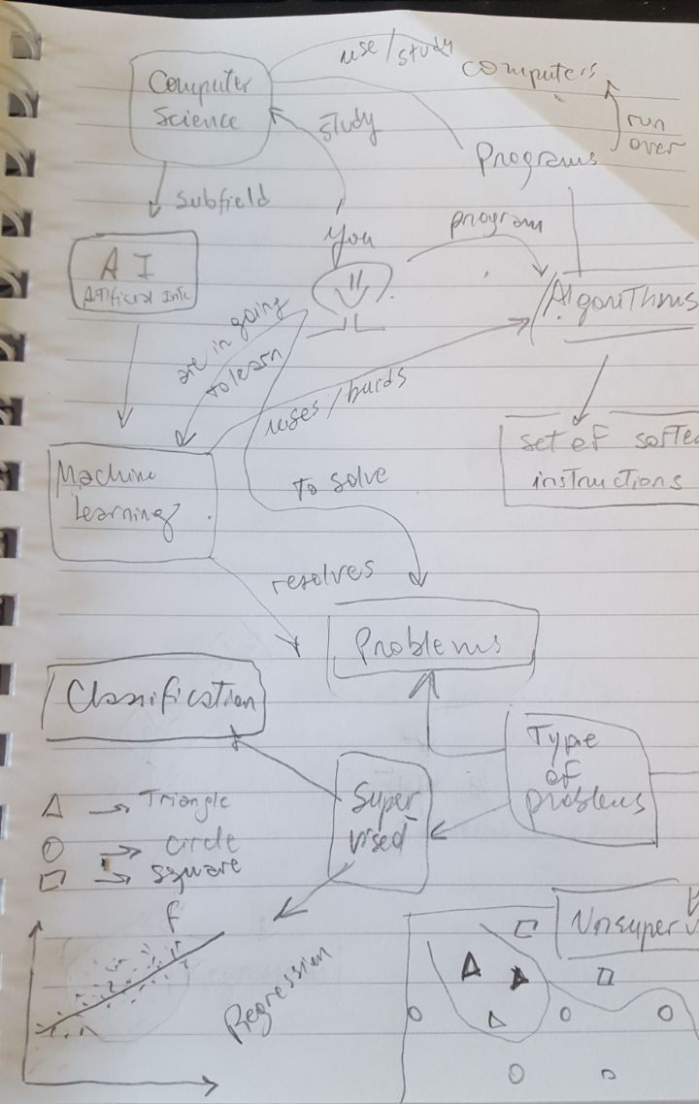
Machine Learning
Notes:
Ana Laura Diedrichs

Slide 28
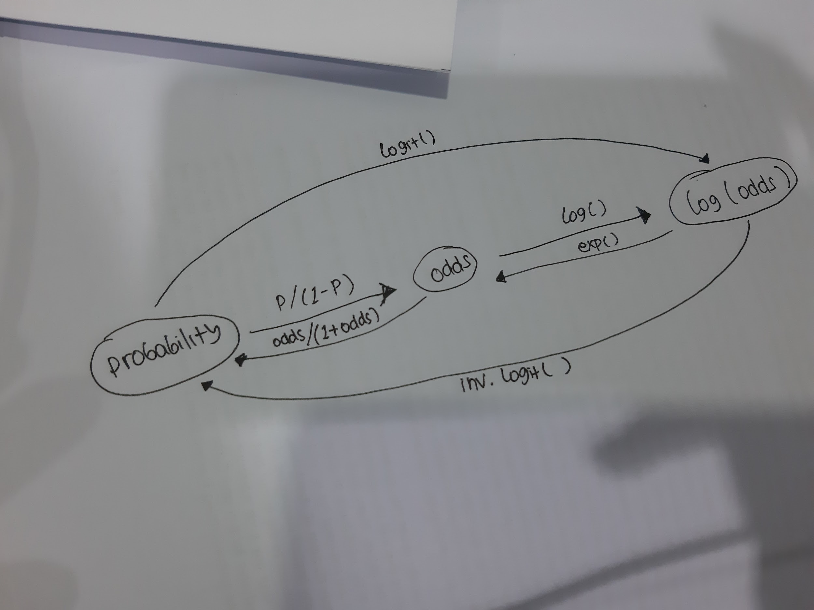
Log Odds
Notes:
Tanesya Tresna

Slide 29
Identifiability Assumptions for Causal Inference
exchangeability
exposure
we measured
well measured?
share
well defined?
confounders
consistency
are
outcome
other variables
associations
prob>0
if categories are combined
positivity
Notes:
Paloma Rojas Saunero
Redrawn by: Ildi Czeller

Slide 30
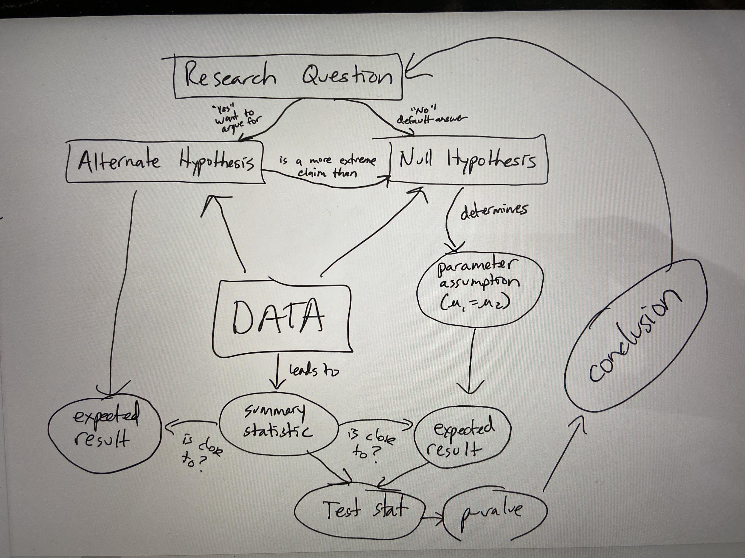
Research Workflow
Notes:
Kelly Bodwin

Slide 31
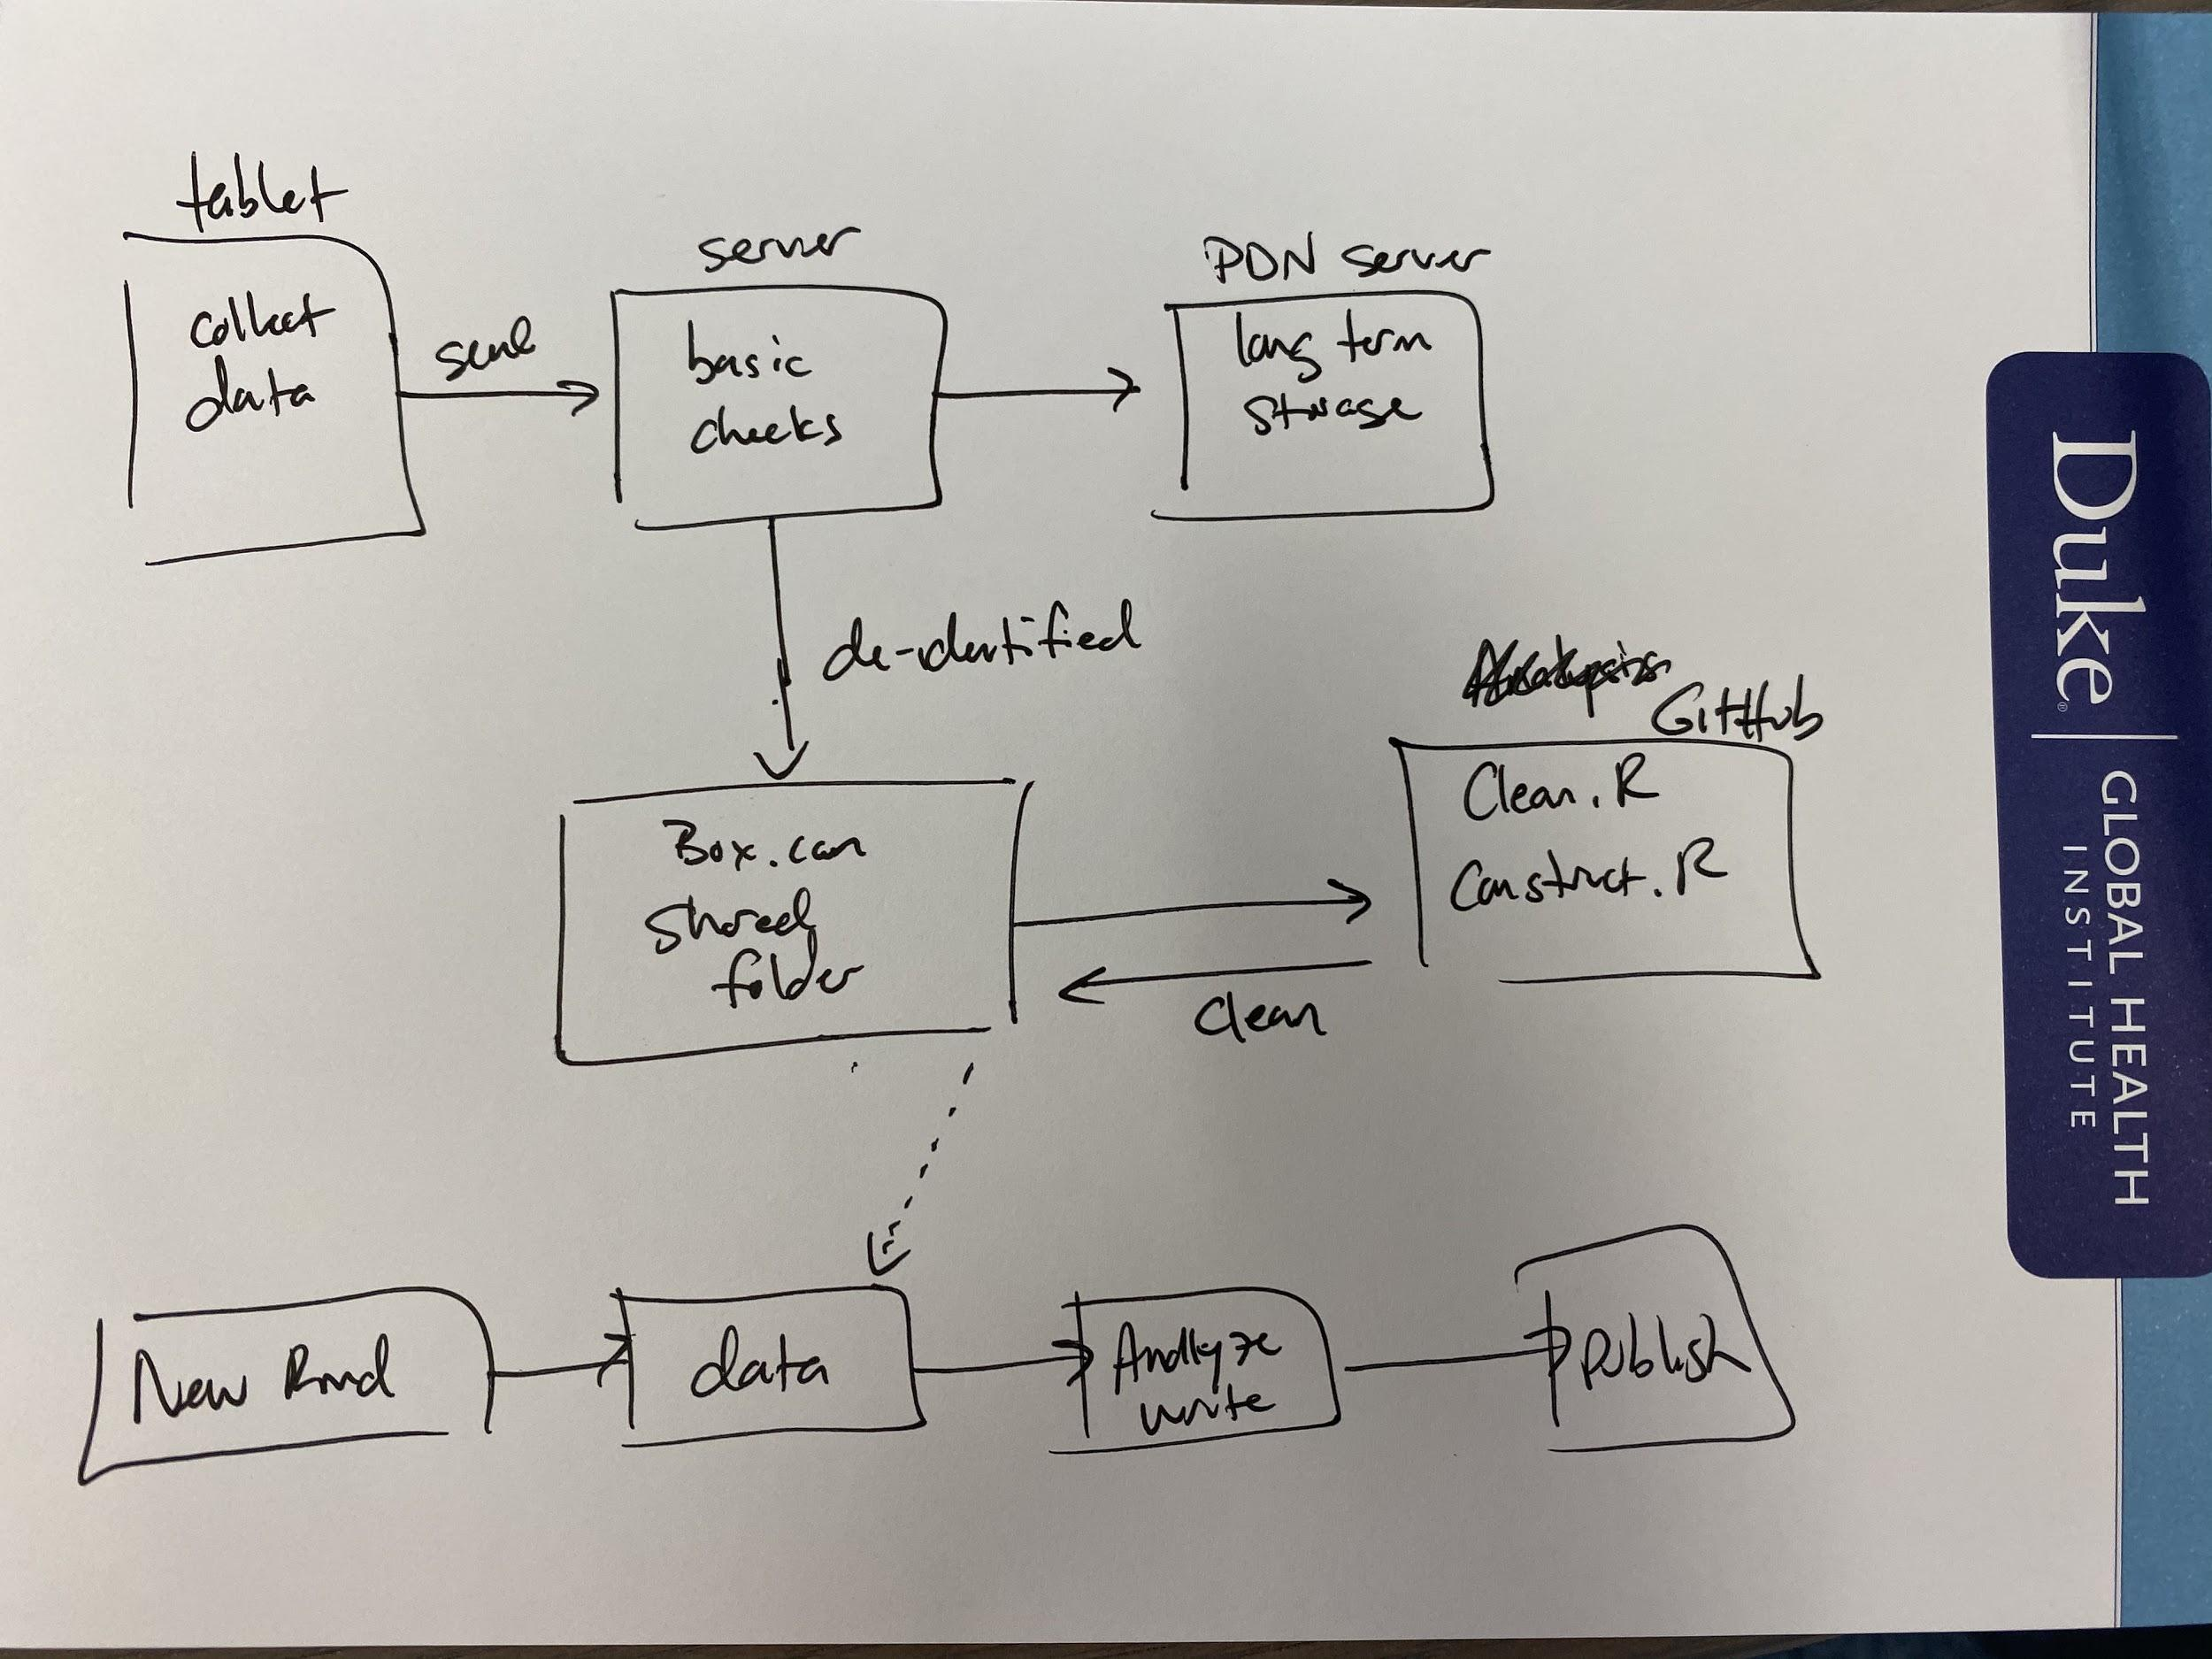
Data Analysis Workflow
Notes:
Eric Green

Slide 32
Experimental Design
Response surface methodology
Evolutionary
Operation
Experimental design
Response surface methodology
Path of Steepest Ascent
Full Factorials
Factors and Factorials
Main effects
& Interactions
Quadratic Models
Design resolution
Canonical Analytics
Augmenting
Blocking
Foldover design
Notes:
Neil Diamond
Redrawn: Florencia D’Andrea

Slide 33
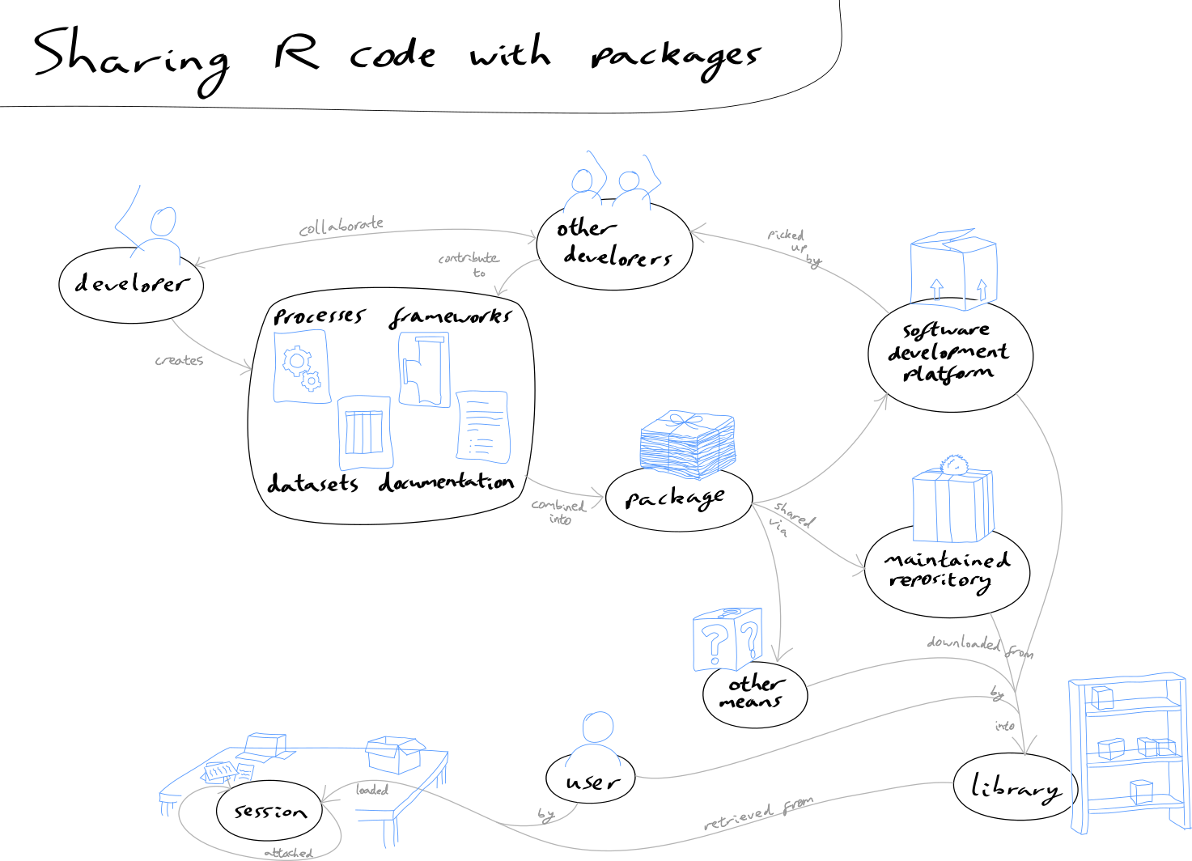
Sharing R Code as Packages
Notes:
Owen Jones

Slide 34
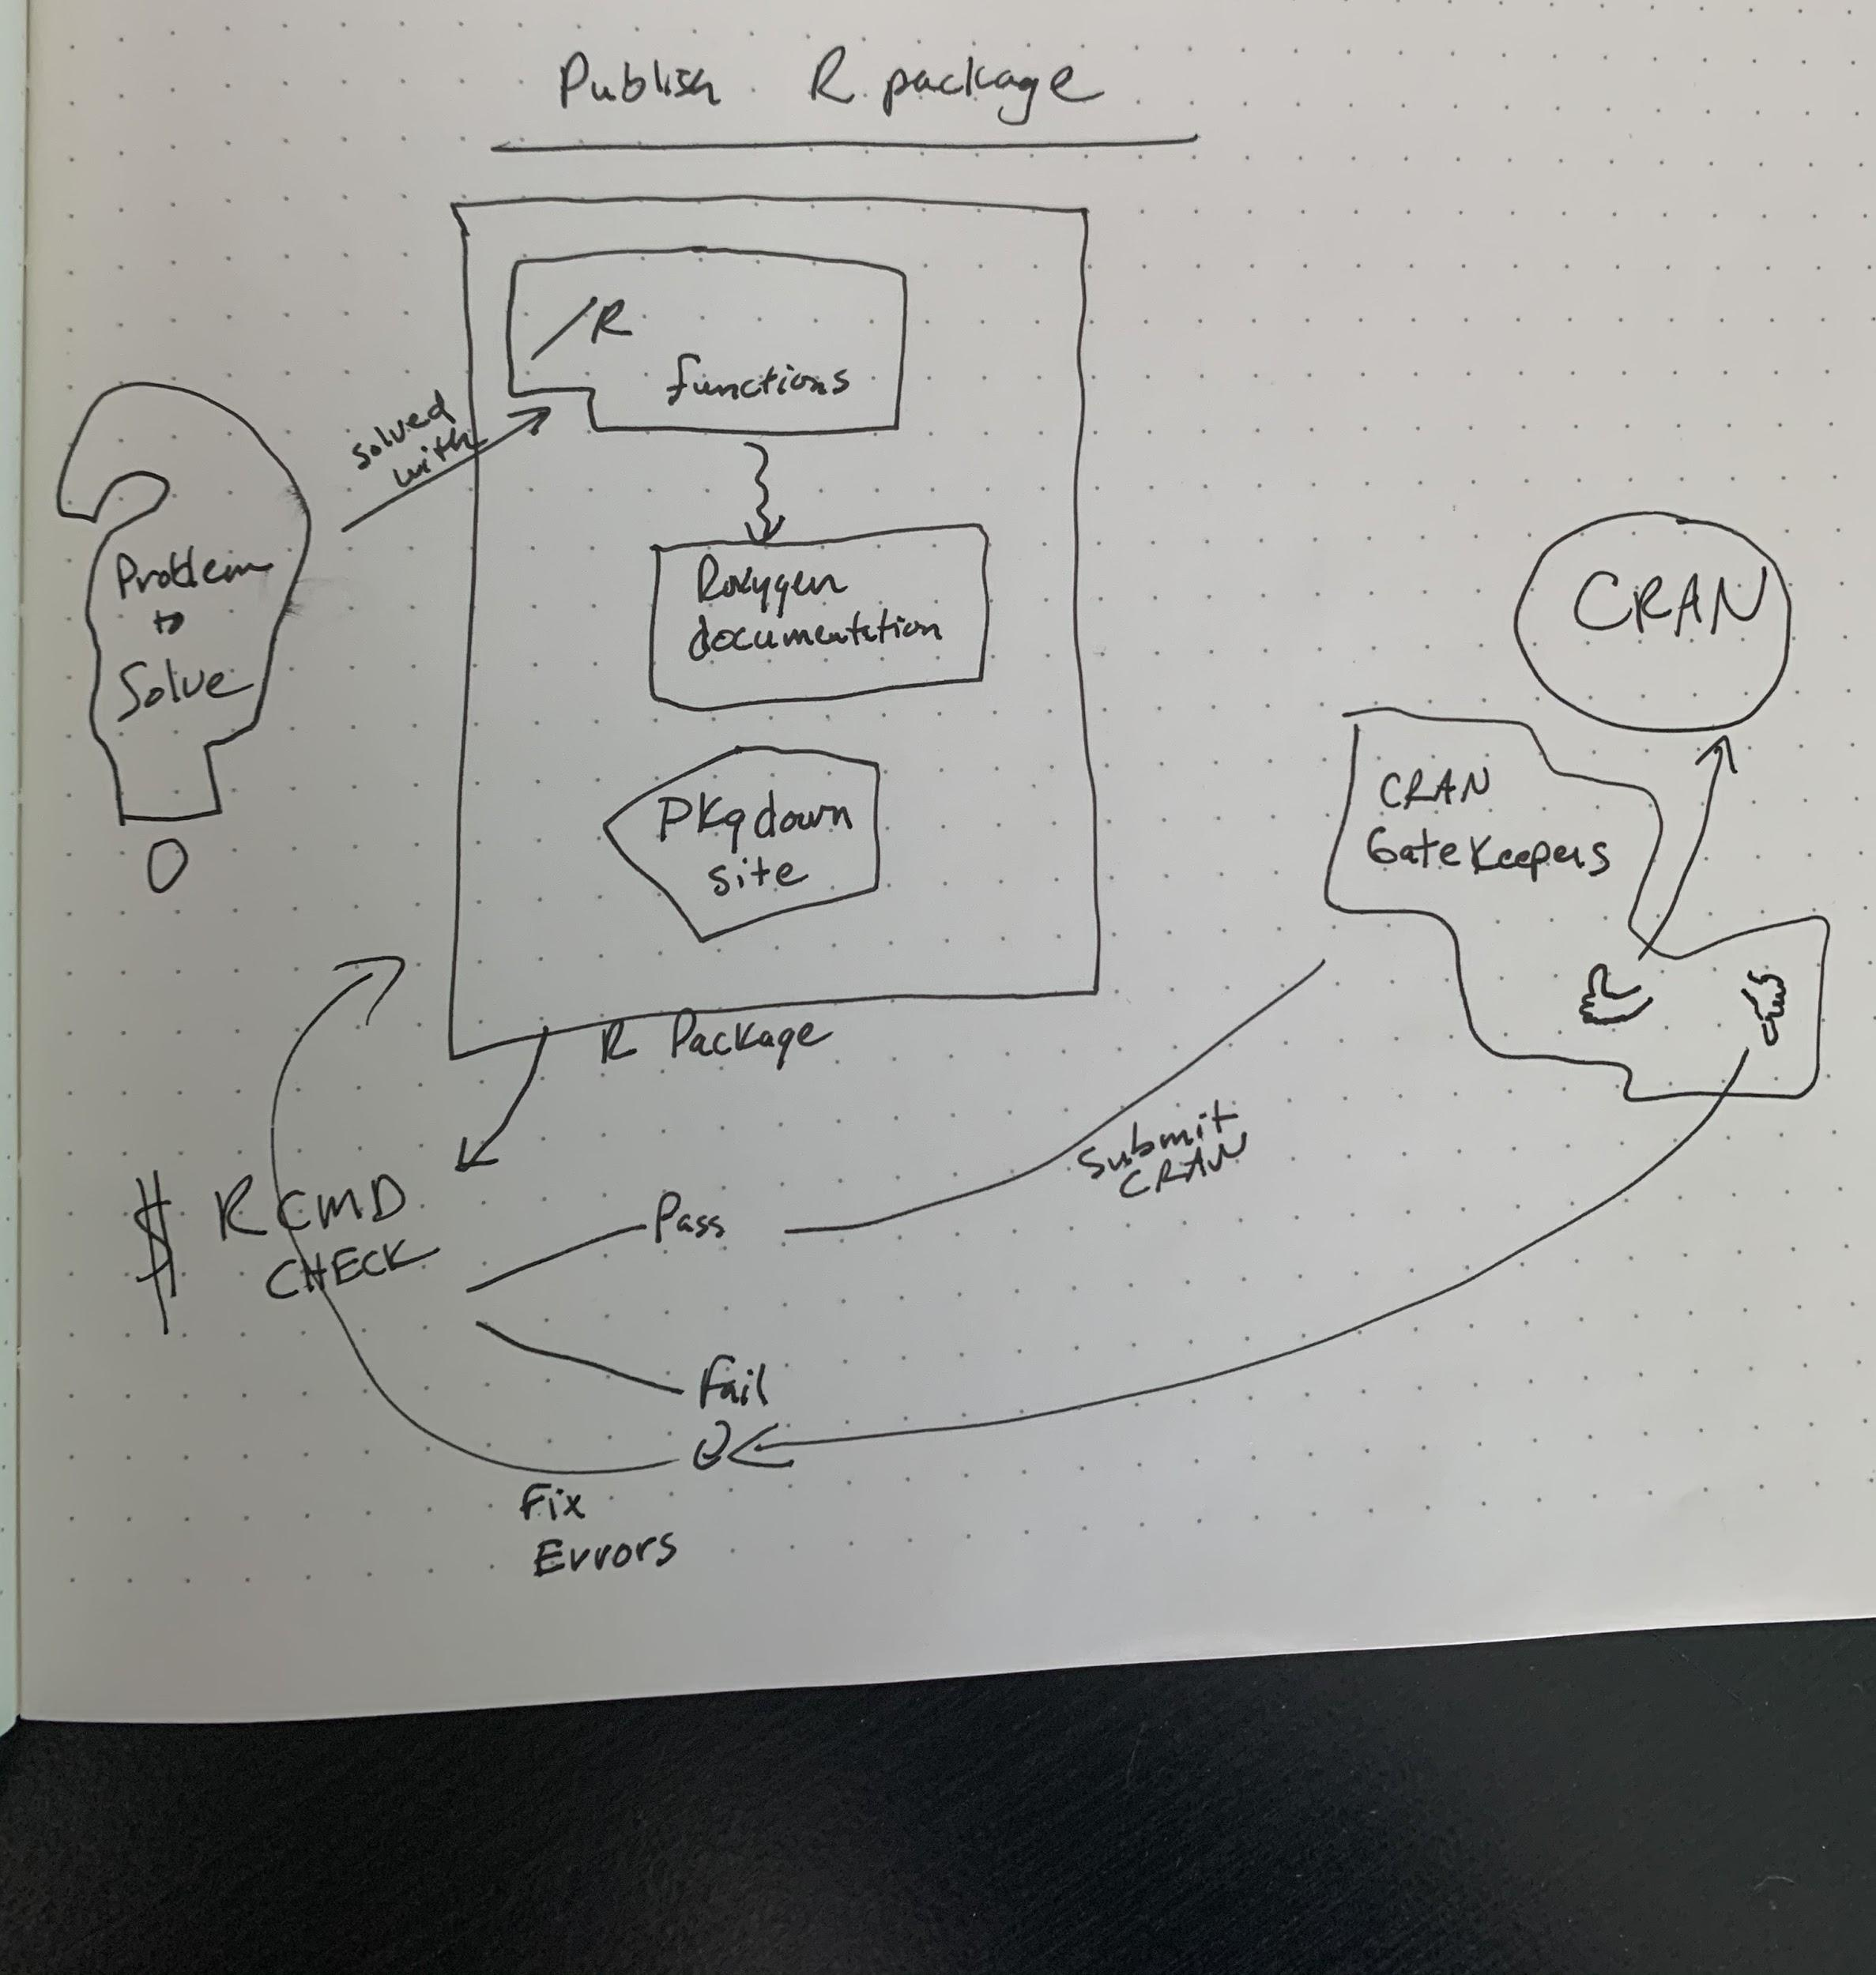
Publishing an R Package
Notes:
Brad Lindblad

Slide 35
HTML
<head>
like
have
mandatory
document
are
some are
Web page
are made with
of
is
A Markup Language
HTML
use
define
Marks
parts
always start with
finish with
< >
</ >
Notes:
Yanina Bellini Saibene

Slide 36
Git and GitLab
Git
add
commit
log
checkout
push/pull
𞠡 vocabulary
Git + Gitlab
working alone
in addition
Collaborate with Git & Gitlab
working with someone
before
set up
branch
remotes
Git + Gitlab
for project management
✓ Git
✓ keys
Gitlab
issues
labels
Notes:
Maria Paula Caldas Rivera
Redrawn: Ildi Czeller

Slide 37
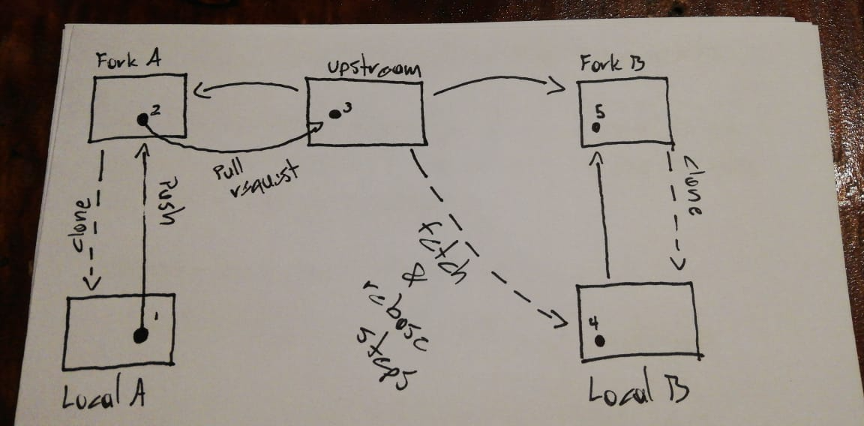
Git Workflow
Notes:
Ronny Hernandez

Slide 38
Git with RStudio and GitHub
store and admin in
Remote repository
GitHub
pull
pull
push
push
add
commit
Contributor computer
Working directory
Staging area
Local repository
RStudio
project
Project directory
RStudio IDE
Your computer
Version control
Notes:
Yanina Bellini Saibene, Marysol Gatti

Slide 39
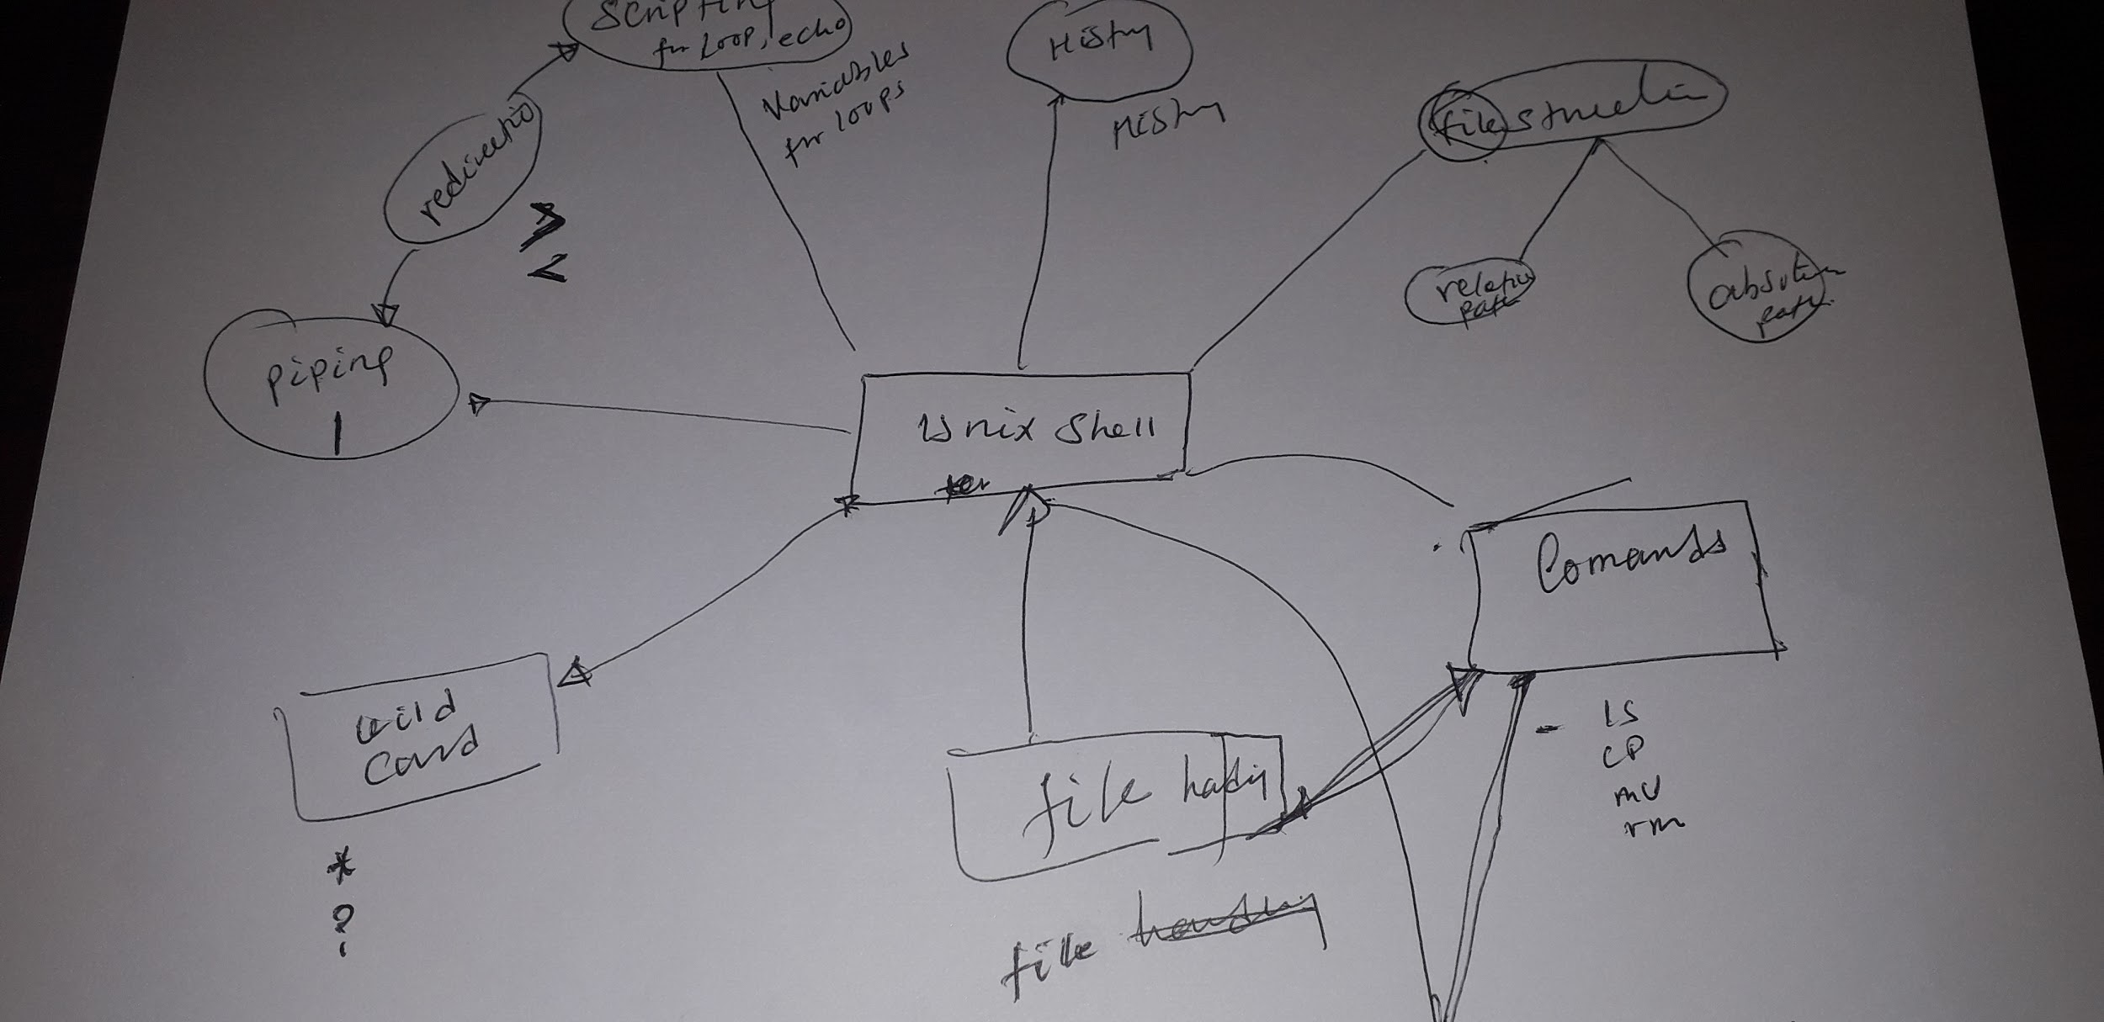
Unix Shell
Notes:
Mesfin Diro Chaka

Slide 40
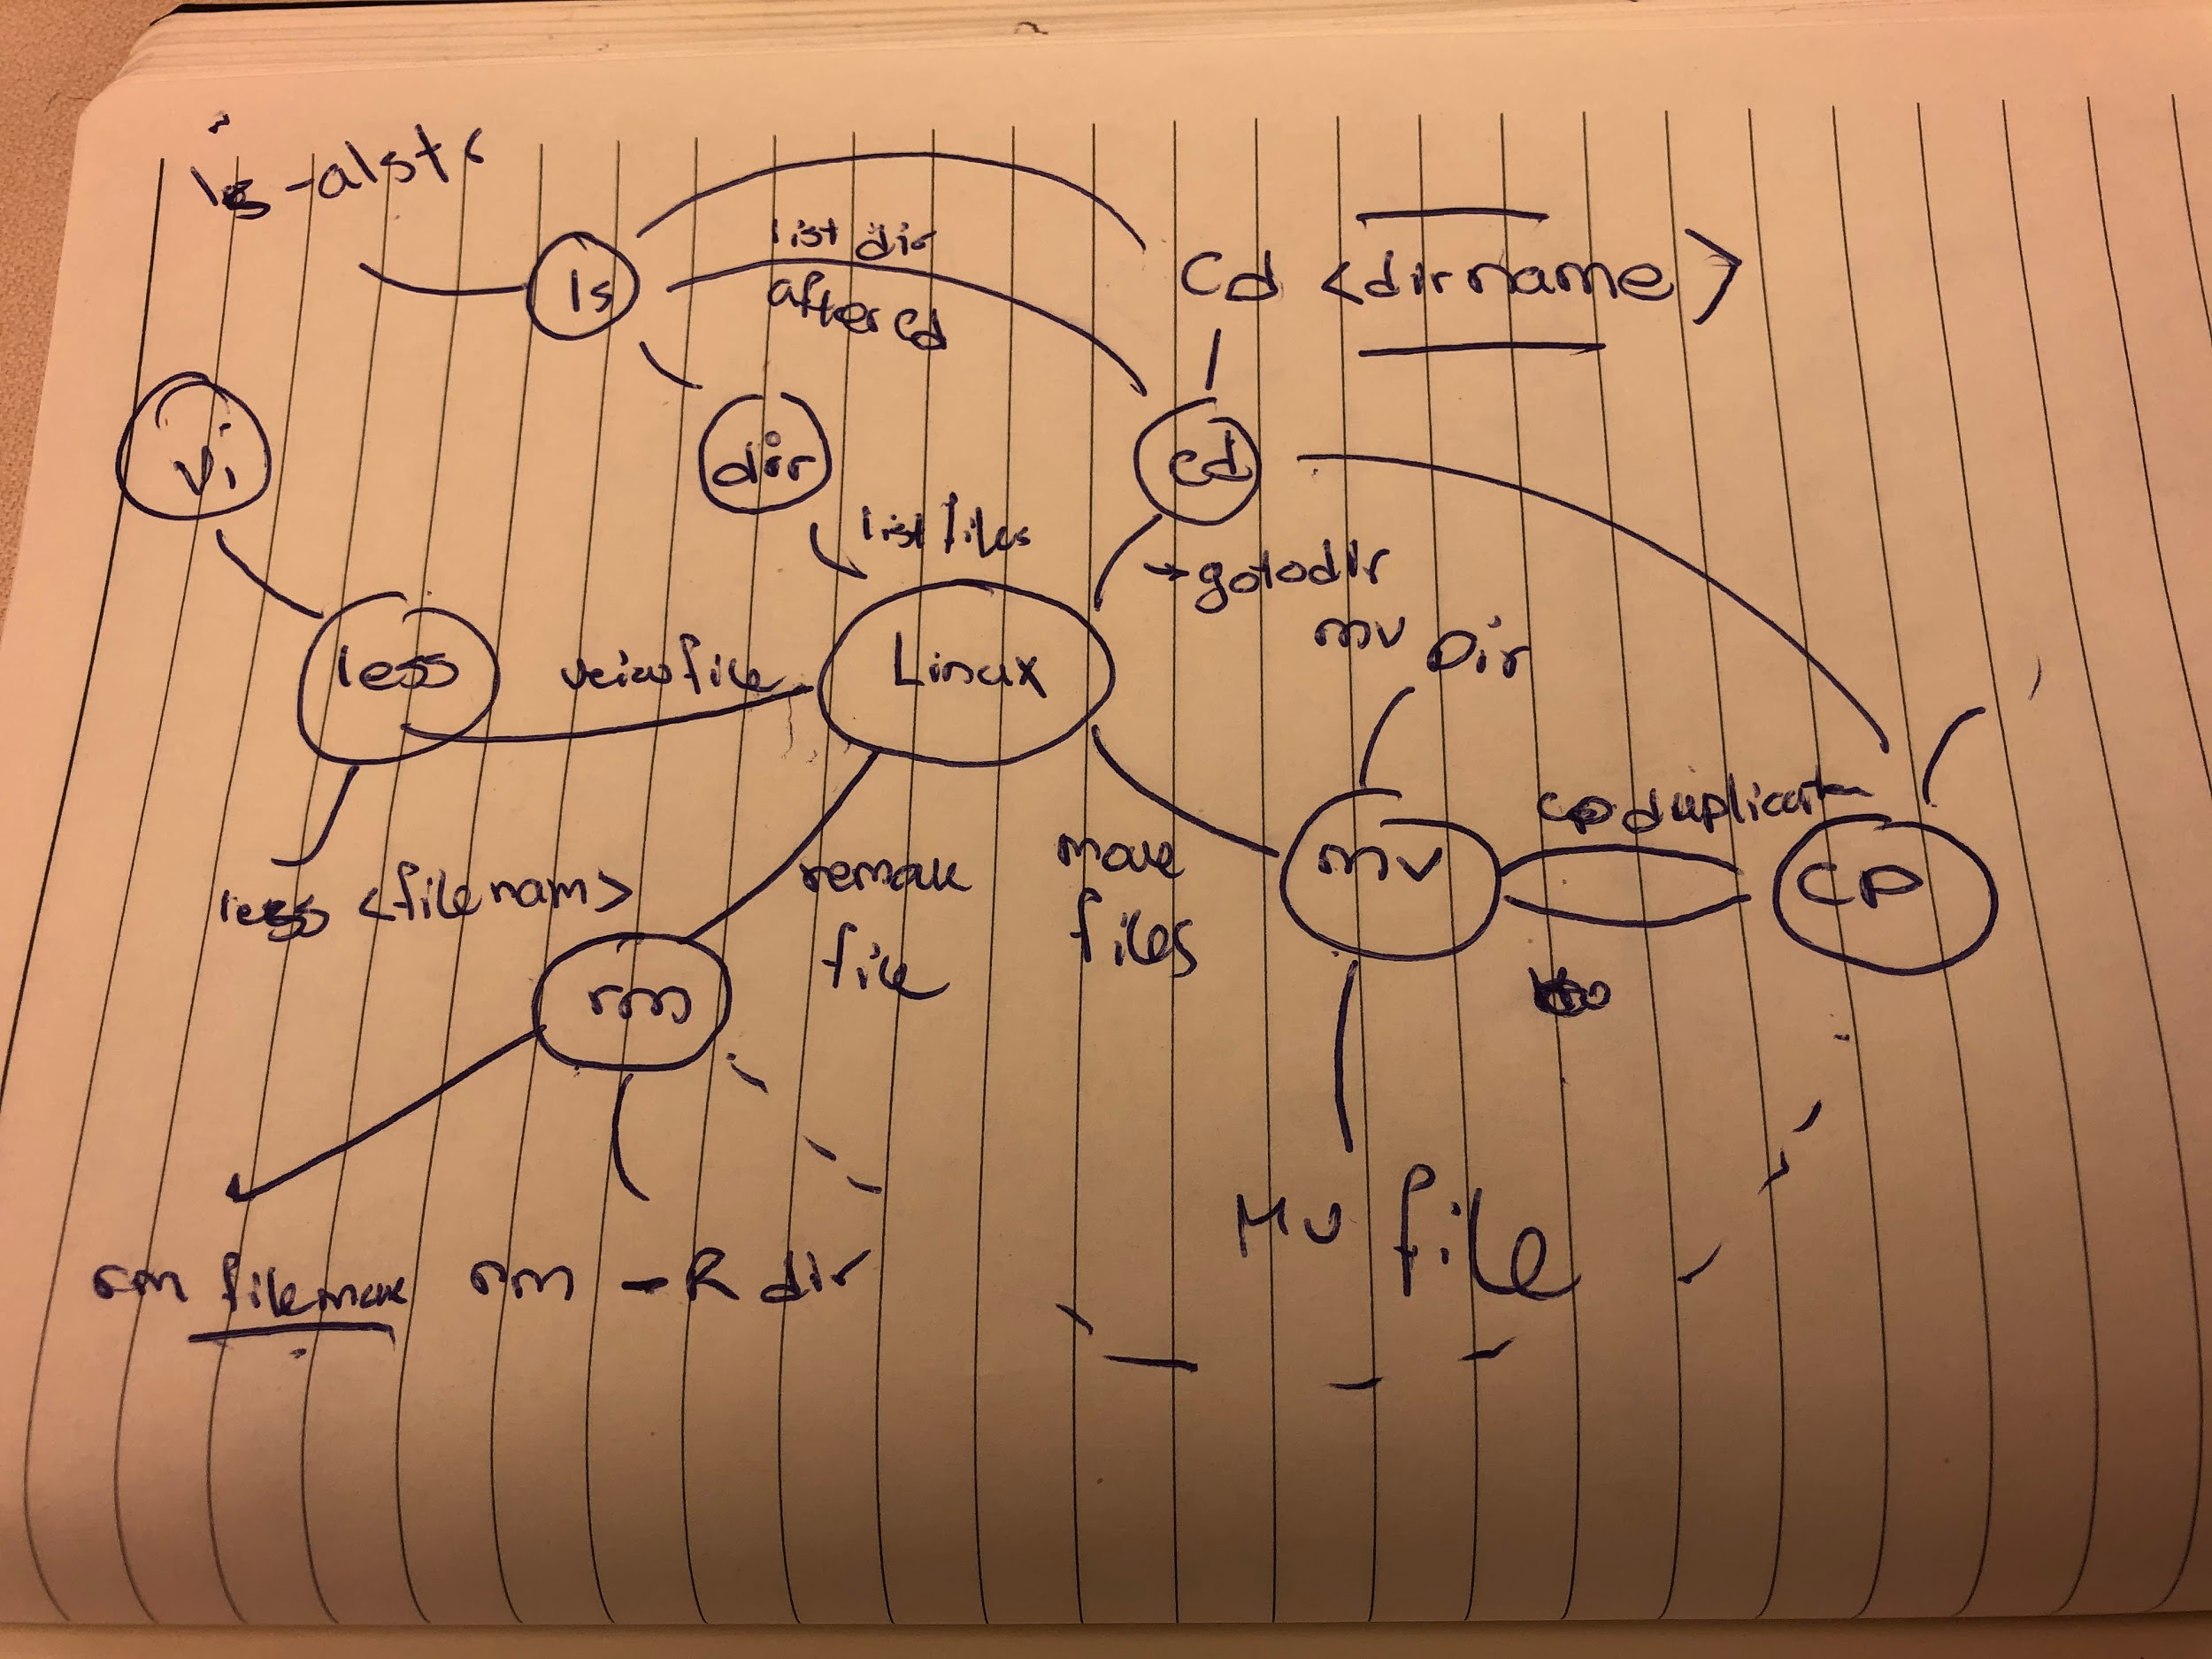
Unix Shell
Notes:
Nima Safaian

Slide 41
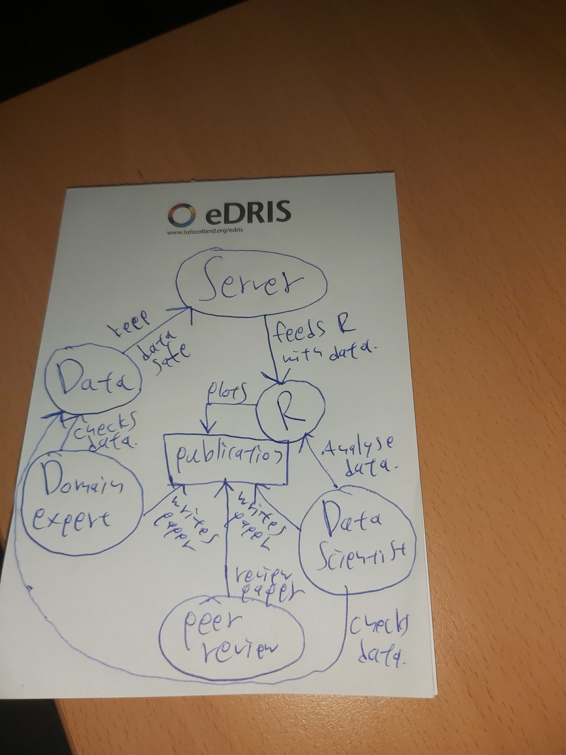
Publishing Data on a Server
Notes:
Dimitrios Doudesis

Slide 42
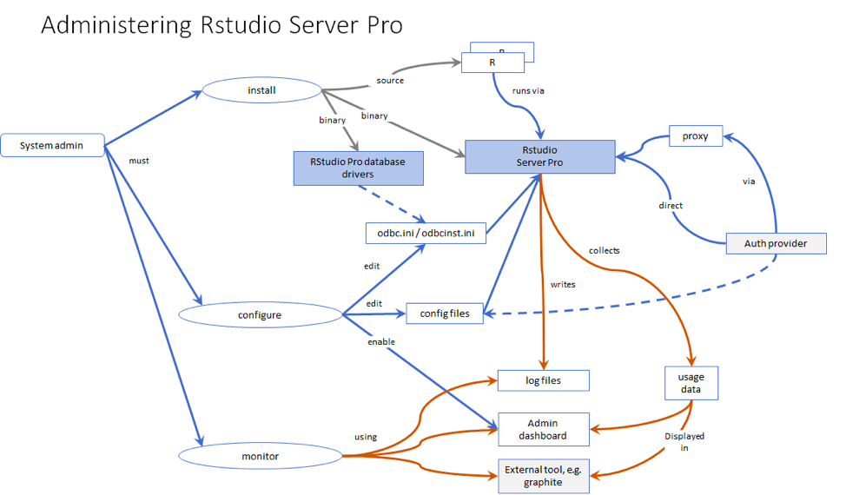
Administering RStudio Server Pro
Notes:
Andrie de Vries

Slide 43
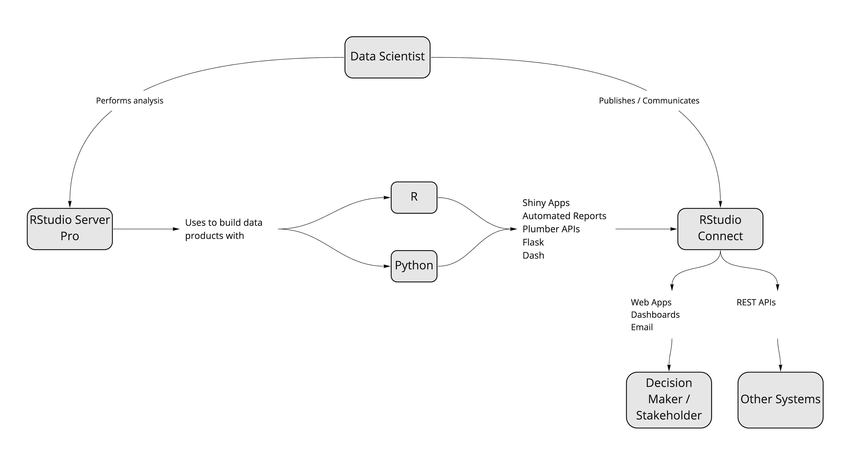
Where Data Scientists Fit In
Notes:
Jason Milnes

Slide 44
Getting Help for R
You get an error in R
NO
YES
COOL / Go on
Try with
See examples
Vignette
R Help
Could you solve it?
google
colleague
to
on
You can (always) ask help
Link your post here
(ask) stack overflow
tutor
(ask) in twitter
online
Notes:
Violeta Roizman
Redrawn: Florencia D’Andrea

Slide 45
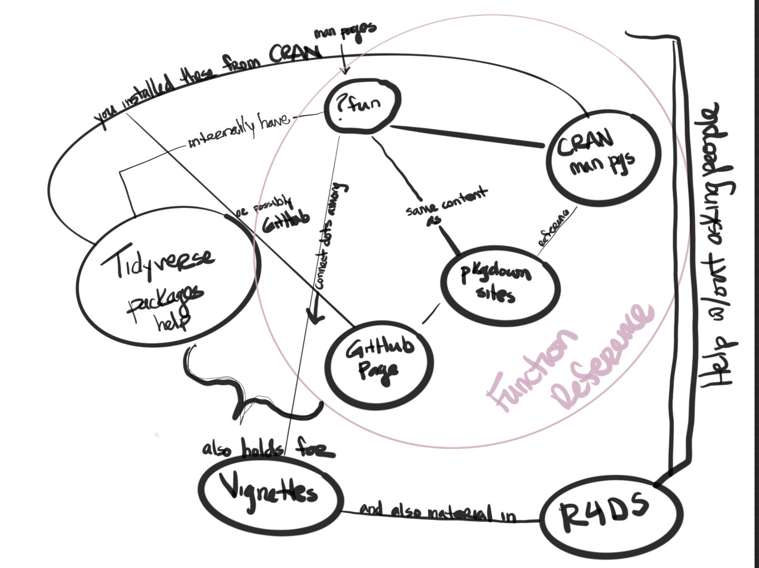
Getting Help for R
Notes:
Mara Averick

Slide 46
Tidyverse and the pipe operator
ecosystem
in R
is an
tidyverse
includes
to wrangle and visualize
includes the operator
data
packages
like
%>%
pipe
helps to
code
readability
readr
dplyr
ggplot2
improve
include
to combine
is defined as
functions
f(x,y) x %>% f(y)
read_csv
filter
select
arrange
ggplot
Notes:
Violeta Roizman - violeroizman@gmail.com

Slide 47
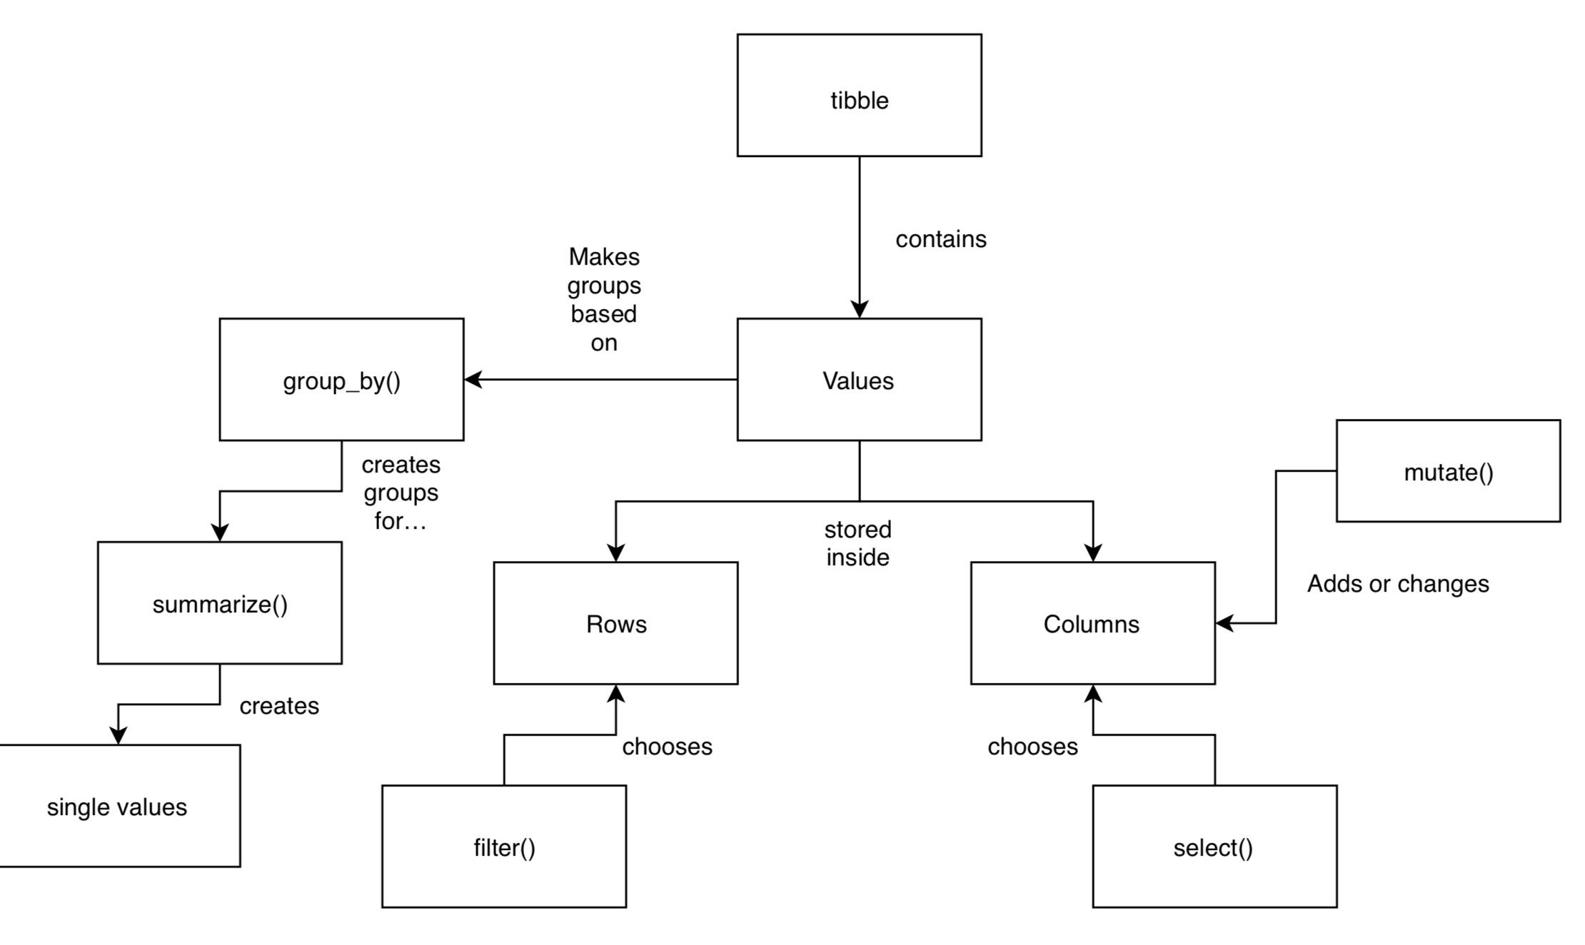
Main dplyr Verbs
Notes:
Andrew Heiss

Slide 48
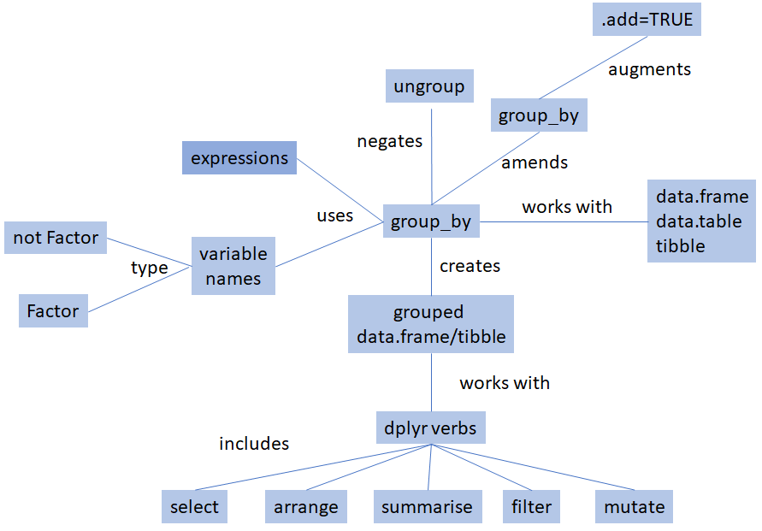
dplyr grouping

Slide 49
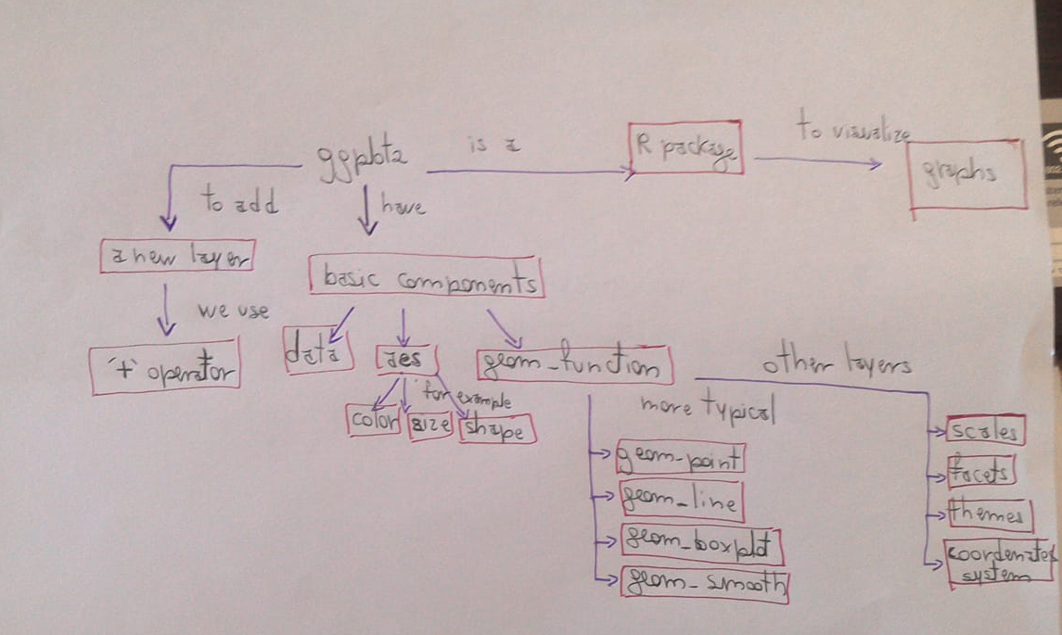
ggplot2
Notes:
Patricia Loto

Slide 50
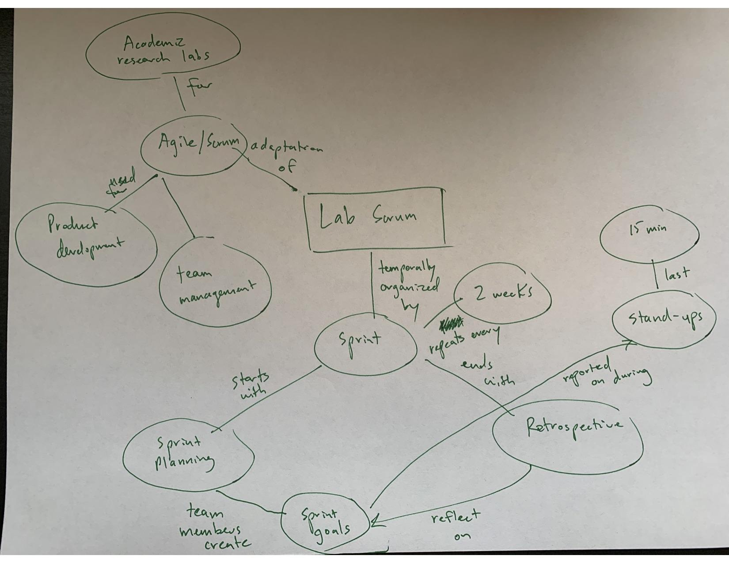
Agile Development
Notes:
Brendan Cullen

Slide 51
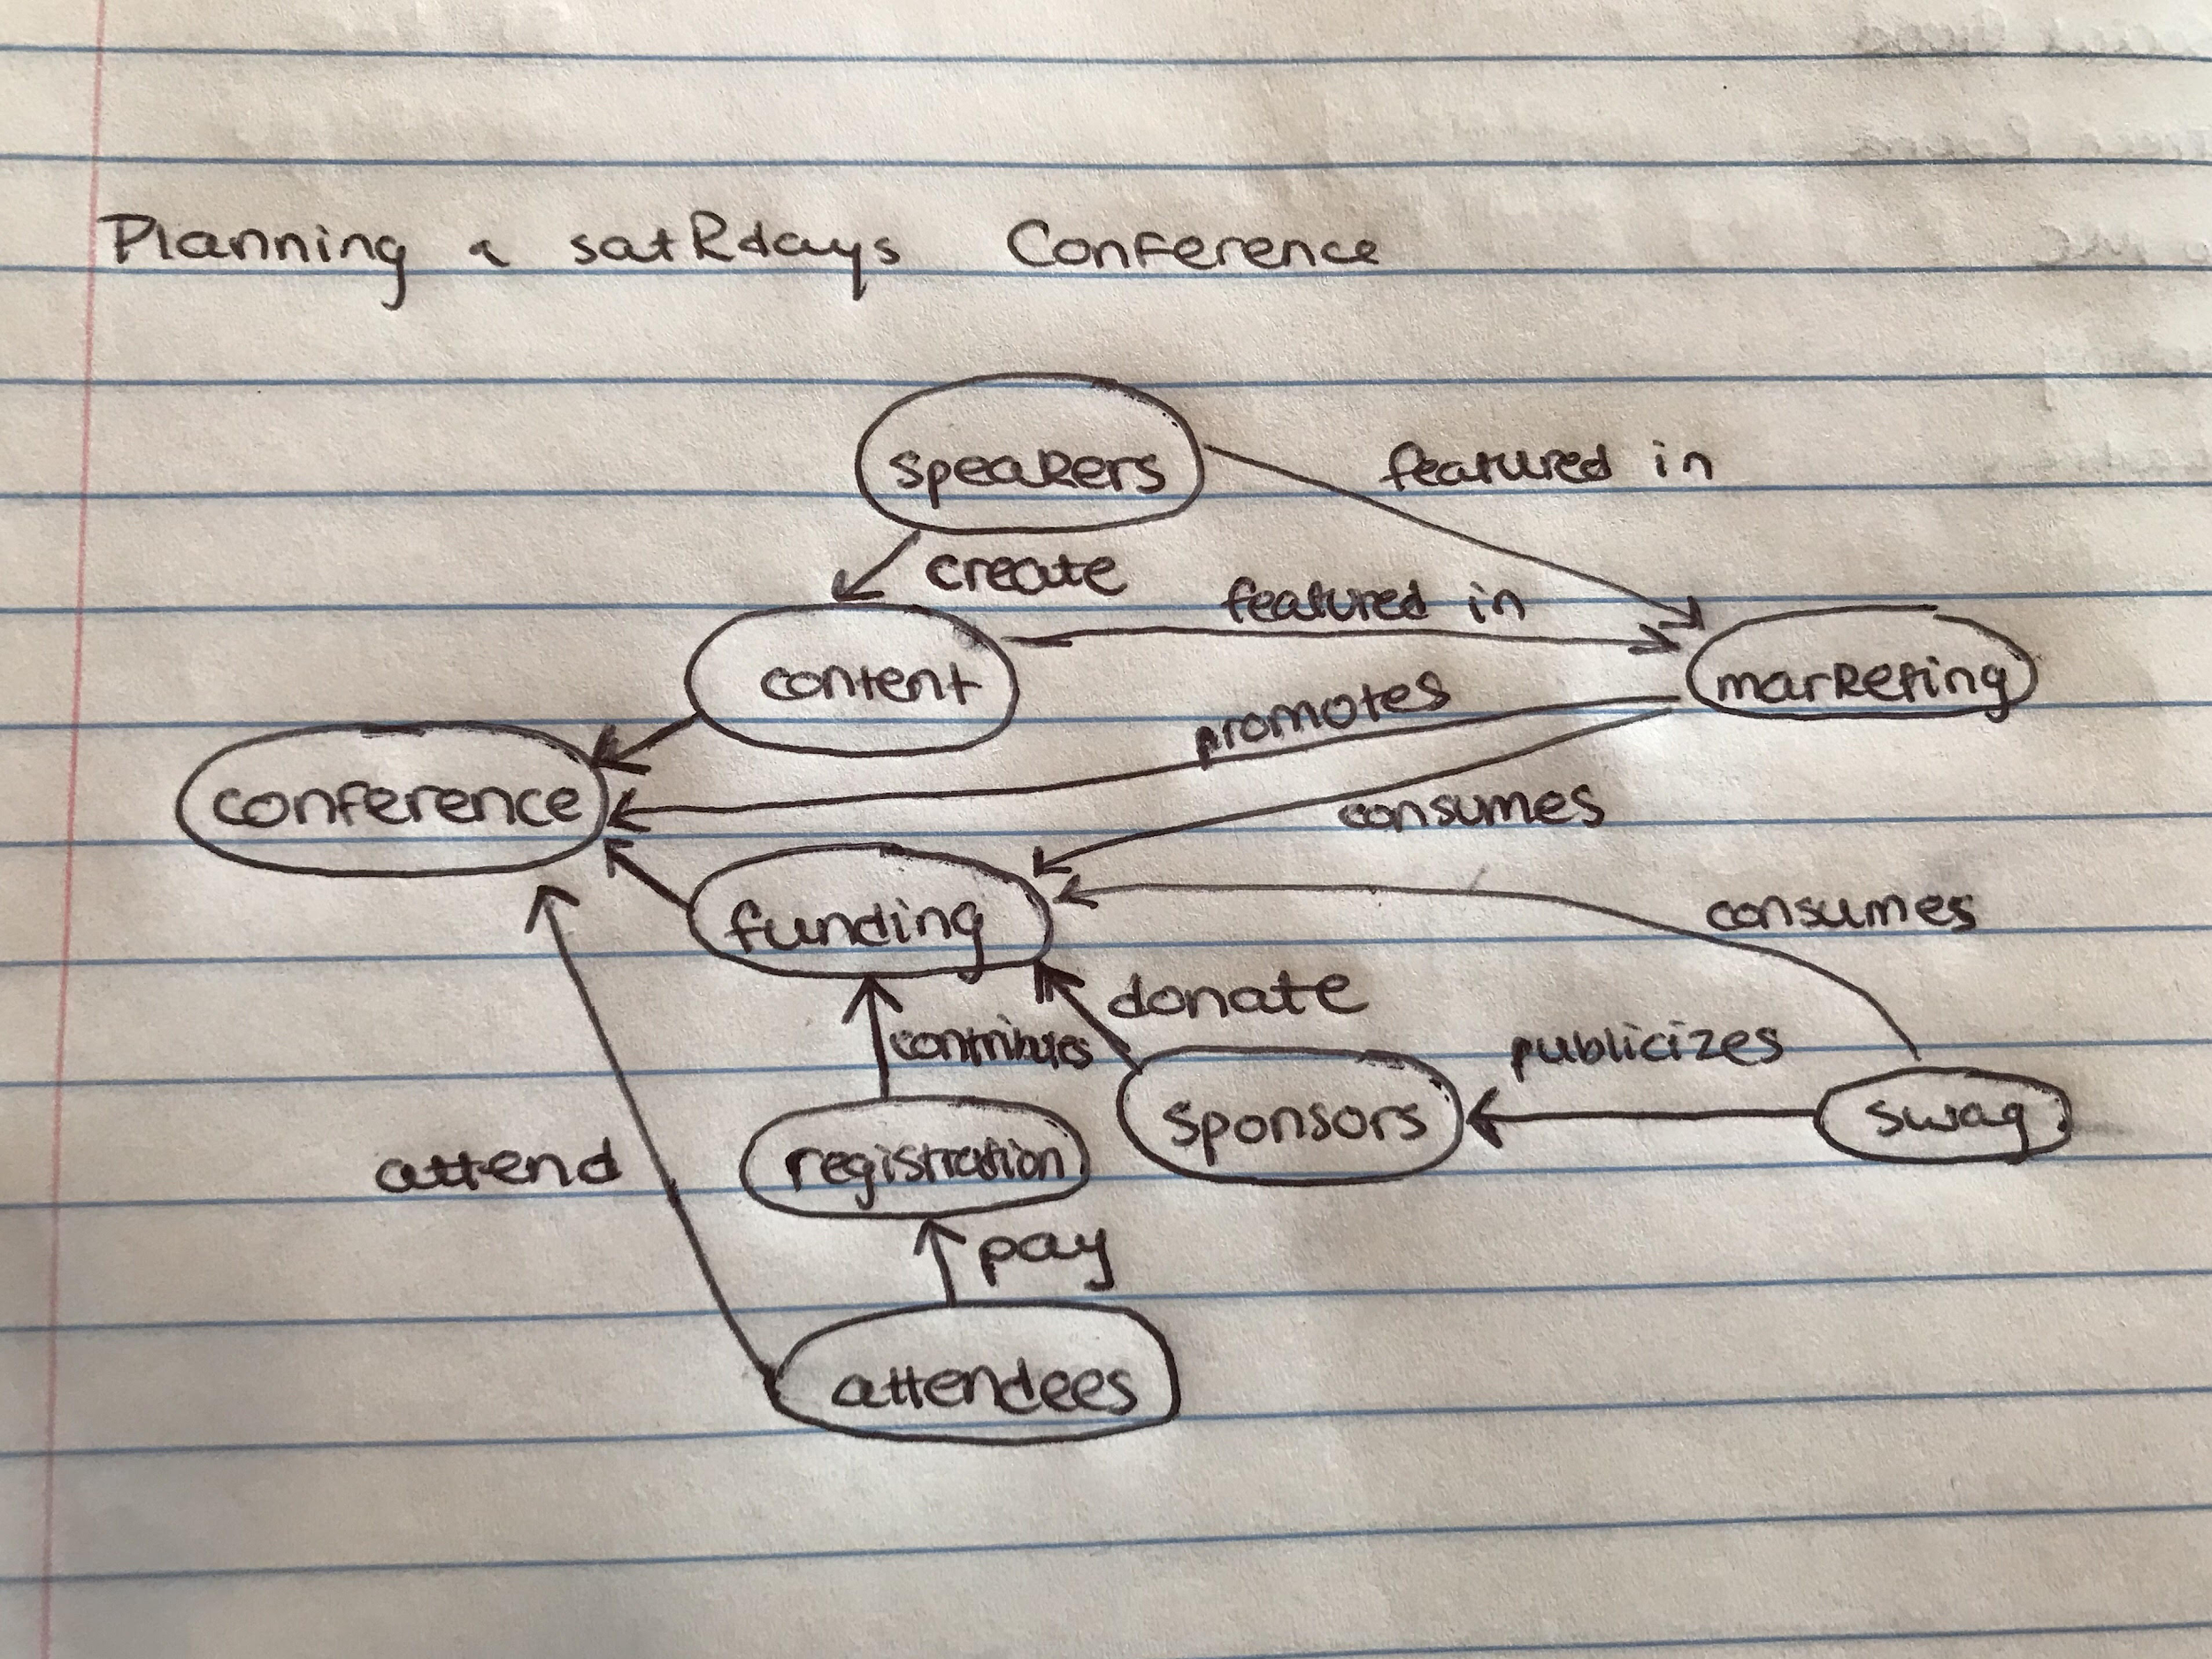
satRday Planning
Notes:
Emily Riederer

Slide 52
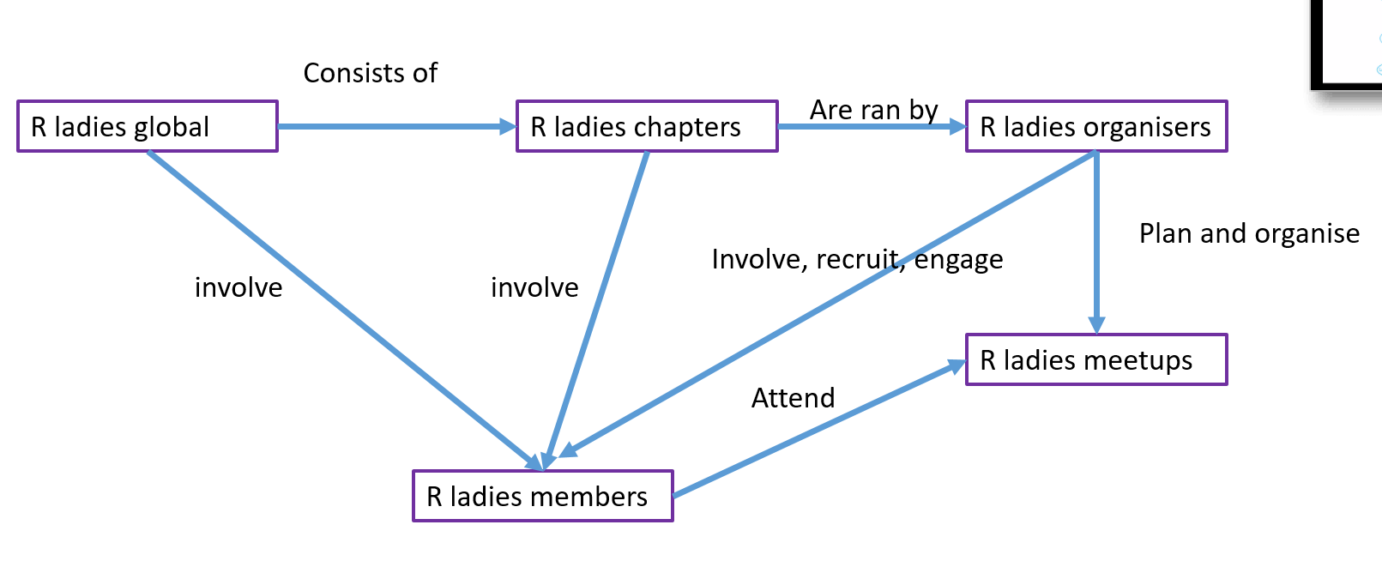
R-Ladies
Notes:
Kasia Kulma

Slide 53
How to Set-up an R-Ladies Chapter
give instruction
Send email to info@rladies.org
Events
Person
R-Ladies
Search
Join
Set-up
run
has
become
Chapter
has
Organizer
run
create
ask for
Meetup Account
create
ask for
Email Account
give access
maintains
Github
Repo
create/maintains
Social Media
give access
engage
Slack
Notes:
Yanina Bellini Saibene

